Slide 1
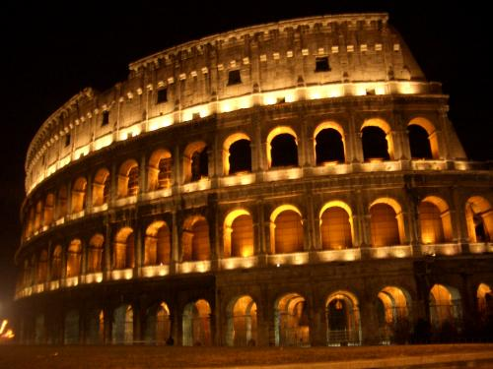
The legacy of Rome
Standard 6.7.8: Discuss the legacies of Roman Art and architecture, technology and science, literature, language, and law.

Slide 2
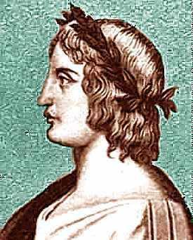
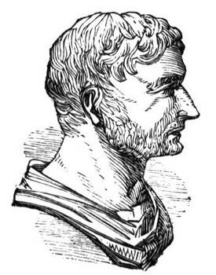
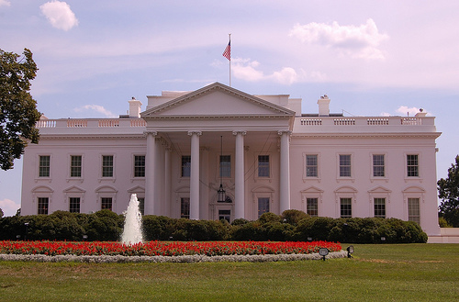
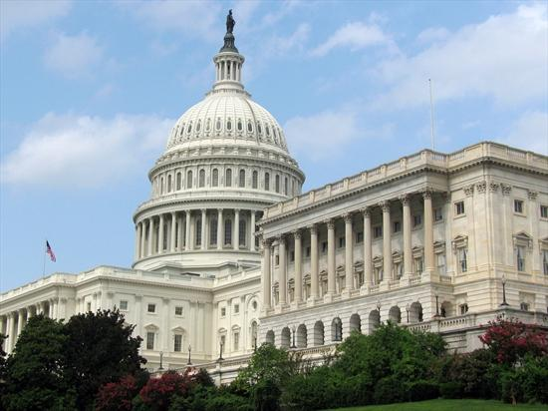
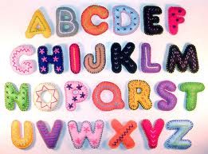
Rome’s Influences on Today
Culture
Alphabet
English words
Roman writers: Virgil, Horace, and Livy
Roman architecture

Slide 3
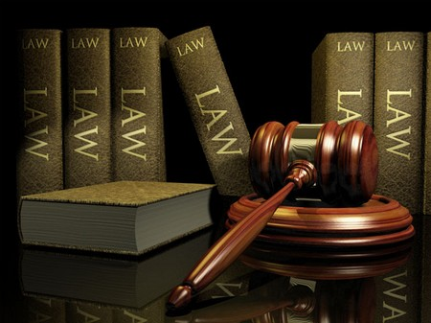
Rome’s Influences on Today (Cont.)
Government
All people are equal under the law
Innocent until proven guilty
Citizenship
Christianity
One of the major religions today

Slide 4
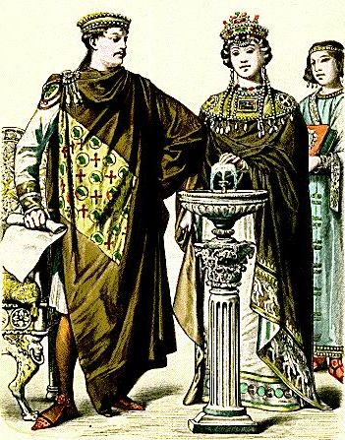
The byzantine empire
Standard 7.1.3: Describe the establishment by Constantine of the new capital in Constantinople and the development of the Byzantine Empire, with emphasis on the consequences of the development of the distinct European civilizations, Eastern Orthodox and Roman Catholic, and their two distinct views on church-state relations

Slide 5
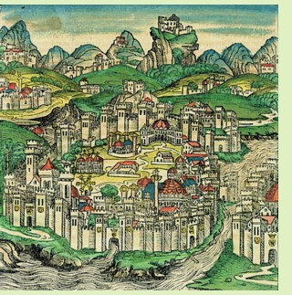
Constantinople (kahn-stan-tuhn-OH-puhl)
Capital of the Byzantine Empire
By 500s A.D. – one of the world’s great cities
Location
Between Black Sea and Aegean Sea
Secure land

Slide 6
Map

Slide 7
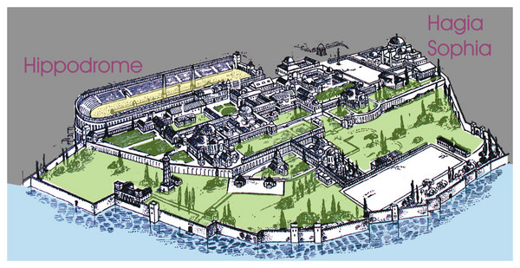
“New Rome”
Roman ways
Buildings and palaces
Hippodrome
Political
Emperors spoke Latin
Enforce Roman laws
Social life
Poor: received free bread and shows
Rich: lived in town or on large farming estates

Slide 8
Less Rome, More Greek
Most spoke Greek
Emperors and officials
Other Influences
Egyptians, Slavs, Persia
All cultures blended together to form the Byzantine civilization
Byzantines = one of richest and most advanced empires (500 A.D. – 1200 A.D.)

Slide 9
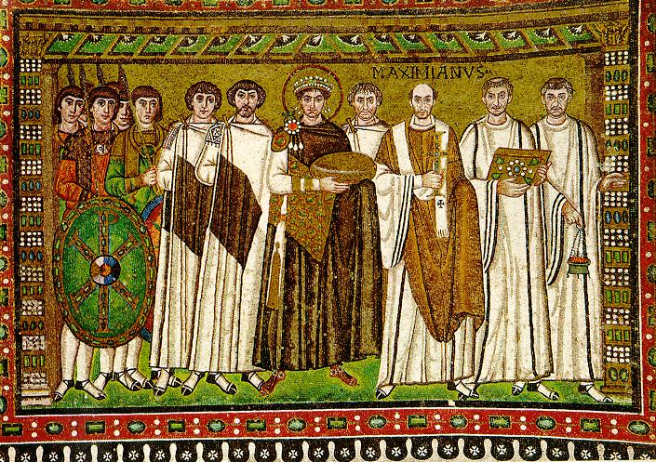
Emperor Justinian
527 A.D. – 565 A.D.
Strong Leader
Controlled military
Made laws
Supreme judge

Slide 10
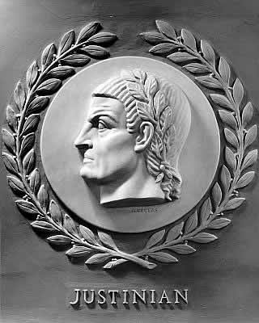
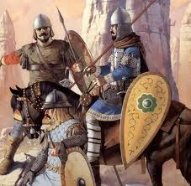
Justinian’s Conquests
Reunite the Roman Empire
General Belisarius (beh-luh-SAR-ee-uhs)
Reorganized the Byzantine army
Cavalry
Armors
Bows and lances
Conquered most of Italy, northern Africa, and Persia

Slide 11
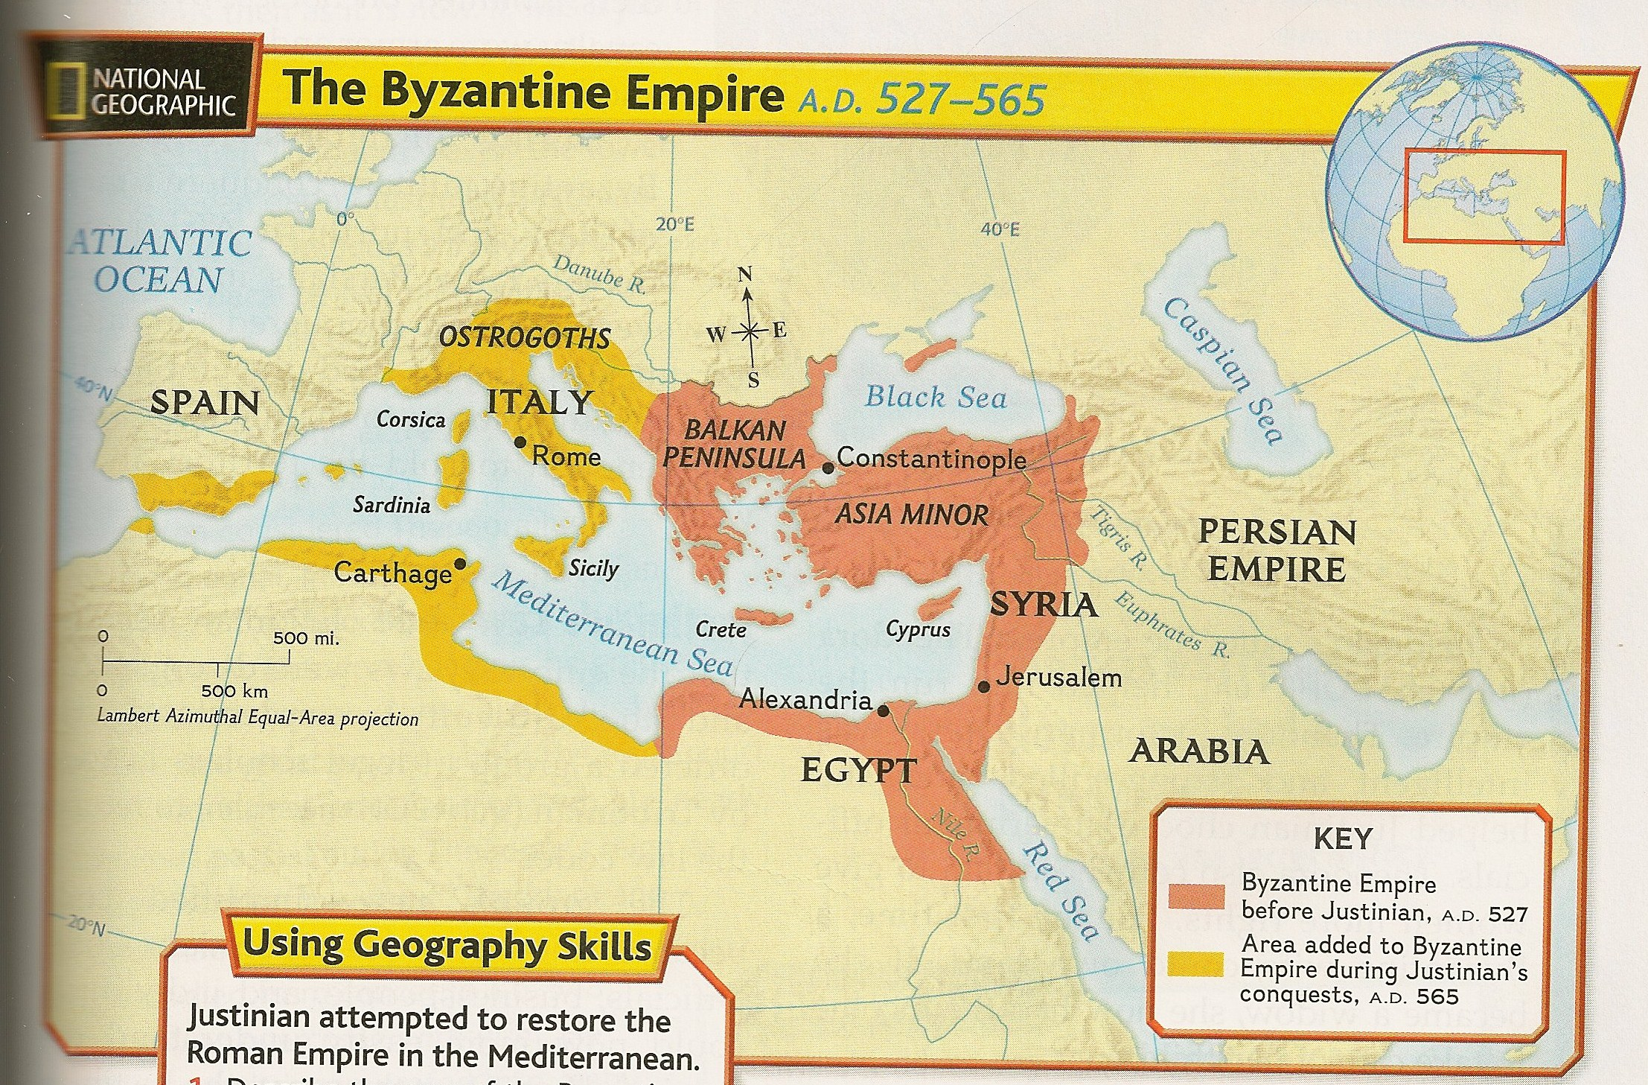
Map

Slide 12
Justinian Code
The empire’s laws were disorganized and hard to understand
Group of legal scholars
Tribonian (truh-BOH-nee-uhn) to reform the law code
Simplified code = Justinian Code
Great influence on the laws of most country in Europe

Slide 13
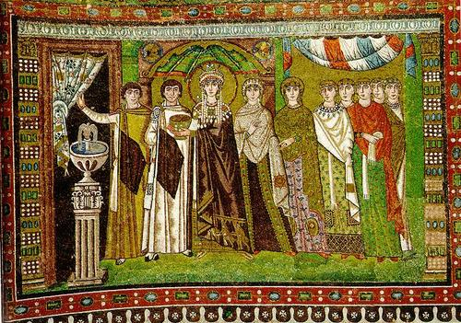
Empress Theodora
Wife of Justinian
Former actress (lower class)
Intelligent and strong willed
Justinian’s intellectual equal
Asked for her advice: laws and policies
Help choose government officials

Slide 14
Empress Theodora (cont.)
Women’s Rights
Property ownership
Divorce
Gave mothers some guardianship rights over their children
Forbid the killing of a wife who committed adultery
Helped save Justinian’s throne

Slide 15
Byzantine civilization

Slide 16
Trade
From 500s A.D. – 1100s A.D.
Center of trade
From Asia: spices, gems, metals, and cloth
Byzantine merchants: farm goods, furs, honey, and enslaved people from northern Europe
Enormous trade = Wealthy empire
Silk weaving
Developed around 550 A.D.
Smuggle silkworm eggs out of China

Slide 17
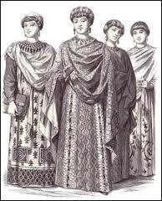
Women
Family = center of social life
Expected to stay home and take care of their family
Some became well educated
Involved in politics
Royal women served as regent
Regent – a person who stands in for a
ruler who is too young or ill to govern

Slide 18
Education
Highly respected
Government support
Authors wrote about religion
Obey God
Lives of saints
Byzantine writers copied and passed on the writings

Slide 19
Education (cont.)
Boys
Girls
Religion, medicine, law, arithmetic, grammar, and other subjects
Hired tutors
Did not attend school
Taught at home

Slide 20
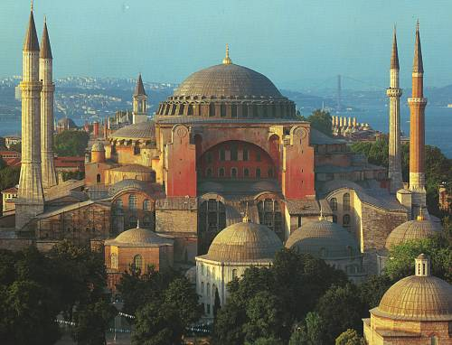
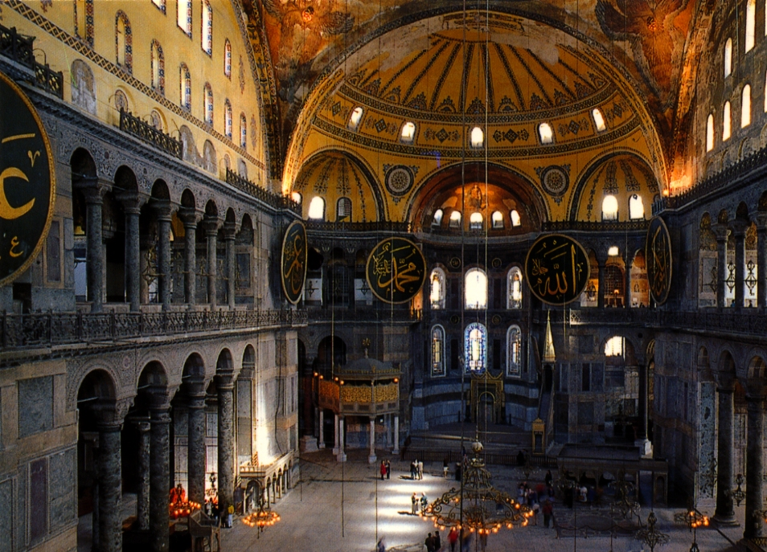
Architecture
Buildings throughout the empire
Constantinople: hundreds of churches and palaces
Hagia Sophia = “Holy Wisdom”
Completed in 537 A.D.

Slide 21
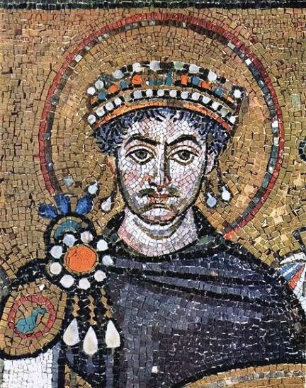
Art
Mosaics – pictures made from many bits of colored glass or stone
Saints or Christian holy people
Bright and rich colored
Decorated
ceilings, domes, and floors of churches
Expensive

Slide 22
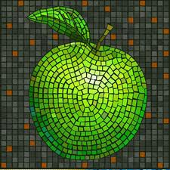
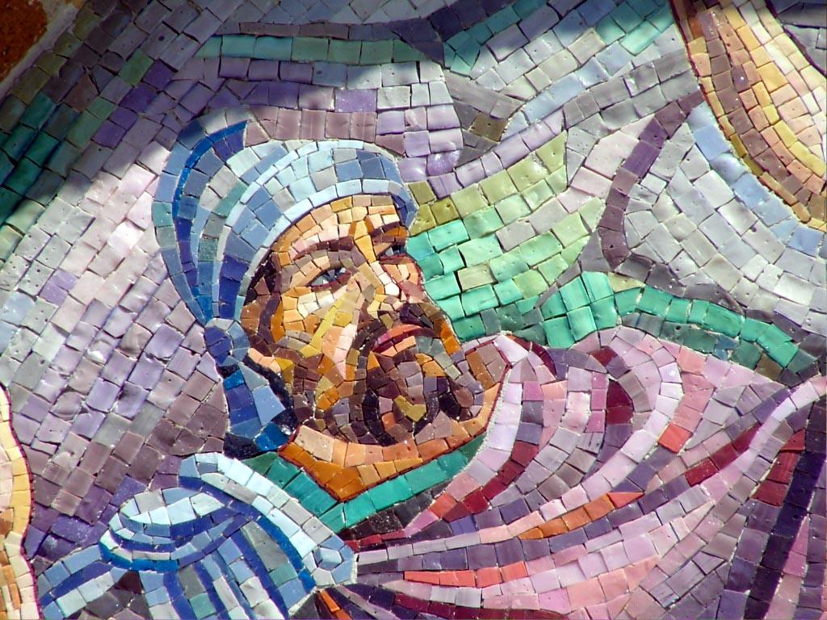
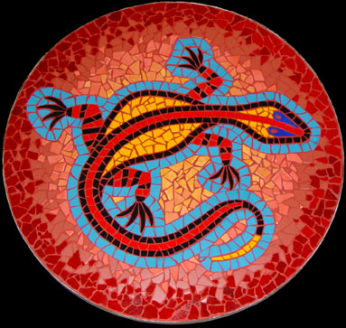
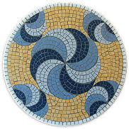
Mosaics

Slide 23
Questions?
Map: Constantinople, Byzantine Empire (?)
Activity Time! ☺

