Slide 1
project and process management
Chapter 4

Slide 2
Objectives
Define the terms project and project management, and differentiate between project and process management.
Describe causes of failed info systems and technology projects.
Describe basic capabilities required of project managers.
Describe basic functions of project management.
PERT vs. Gantt as project management tools.
Describe role of project management software.
Define joint project planning and its role in project management.
Define scope and a write a statement of work to document scope.
Estimate tasks’ durations and specify intertask dependencies.
Assign resources and produce a project schedule with a Gantt chart.
Assign people to tasks and direct the team effort.
Use critical path analysis to adjust schedule and resource allocations in response to schedule and budget deviations.
Notes:
No additional notes.

Slide 3
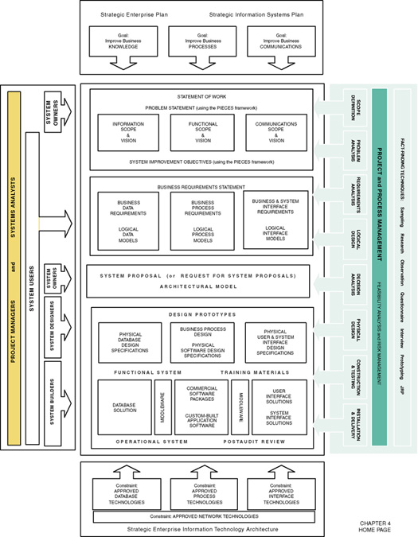
Notes:
Teaching Notes
This slide shows the how this chapter's content fits with the building blocks framework used throughout the textbook. Since project management is an on-going activity, it deals with all phases. Project management is primarily a concern of systems analysts and the project manager.

Slide 4
Projects and Project Managers
Project – a [temporary] sequence of unique, complex, and connected activities having one goal or purpose and that must be completed by specific time, within budget, and according to specification.
Project manager - the person responsible for supervising a systems project from initiation to conclusion
Notes:
No additional notes

Slide 5
Project Management and Process Management
Project management – the process of scoping, planning, staffing, organizing, directing, and controlling the development of an acceptable system at a minimum cost within a specified time frame.
Process management – the activity of documenting, managing, and continually improving the process of systems development.
Notes:
Teaching Notes
Key point to emphasize is that every IT project is unique, a factor that has made project management extremely challenging across the industry. Organizations today are placing considerably more importance on project management skills because of the impact information technology has on the business. Organizations can’t afford the project failures which were very much commonplace in the past.
Project management is a cross life cycle activity.
It can be useful to characterize process management as providing the “templates” (much as a word processor) for project management. But just as word processing templates must be managed and improved from time to time, so must process templates be improved and managed.
Most organizations pursuing the CMM are targeting Level 3, that is, consistently using a standardized process or methodology to develop all systems. CMM Level 2 deals with project management. CMM Level 3 deals with what has come to be known as process management.

Slide 6
Measures of Project Success
The resulting information system is acceptable to the customer.
The system was delivered “on time.”
The system was delivered “within budget.”
The system development process had a minimal impact on ongoing business operations.
Notes:
Teaching Notes
Emphasize that these measurements are from the perspective of the project manager.
Failures and limited successes far outnumber successful information systems. Some studies show that 60-75% of all IT projects can be considered failures.

Slide 7
Causes of Project Failure
Failure to establish upper-management commitment to the project
Lack of organization’s commitment to the methodology
Taking shortcuts through or around the methodology
Poor expectations management
Feature creep– uncontrolled addition of technical features to a system.
Scope creep – unexpected and gradual growth of requirements during an information systems project.
Notes:
Conversion Notes
In the seventh edition the Causes of Project Failure has been split between two slides, partially for readability and partially so that feature creep and scope creep can be included here in a more relevant point.
Teaching Notes
The major cause of project failure—most project managers were not educated or trained to be project managers! Just as good programmers don't always go on to become good systems analysts, good systems analysts don't automatically perform well as project managers. To be a good project manager, you should be educated and skilled in the “art of project management.”

Slide 8
Causes of Project Failure (cont.)
Premature commitment to a fixed budget and schedule
Poor estimating techniques
Overoptimism
The mythical man-month (Brooks, 1975)
Inadequate people management skills
Failure to adapt to business change
Insufficient resources
Failure to “manage to the plan”
Notes:
No additional notes.

Slide 9
Project Manager Competencies
Business awareness
Business partner orientation
Commitment to quality
Initiative
Information gathering
Analytical thinking
Conceptual thinking
Interpersonal awareness
Organizational awareness
Anticipation of impact
Resourceful use of influence
Motivating others
Communication skills
Developing others
Monitoring and controlling
Self-confidence
Stress management
Concern for credibility
Flexibility
(Adapted from Wysocki, Beck, and Crane, Effective Project Management: How to Plan, Manage, and Deliver Projects on Time and within Budget.)
Notes:
Teaching Notes
There exists a core set of competencies that good project managers possess. Some of these competencies can be taught, both in courses, books, and professional workshops; however, you should immediately recognize that some of these competencies come only with professional experience in the field. First, you usually cannot manage a process you have never used. Second, you cannot manage a project without understanding the business and culture that provides a context for the project.

Slide 10
Project Management Functions
Scoping – setting the boundaries of the project
Planning – identifying the tasks required to complete the project
Estimating – identifying the resources required to complete the project
Scheduling – developing the plan to complete the project
Organizing – making sure members understand their roles and responsibilities
Directing – coordinating the project
Controlling – monitoring progress
Closing – assessing success and failure
Notes:
Conversion Notes
Shorthand definitions have been added to these terms.
Teaching Notes
The project management functions were derived from classic management functions.
Project management functions are dependent upon interpersonal communications between the project manager, the team, and other managers.

Slide 11
Project Management Tools & Techniques
PERT chart – a graphical network model used to depict the interdependencies between a project’s tasks.
Gantt chart – a bar chart used to depict project tasks against a calendar.
Notes:
Teaching Notes
The Gantt chart, first conceived by Henry L. Gantt in 1917, is the most commonly used project scheduling and progress evaluation tool.
PERT, which stands for Project Evaluation and Review Technique, was developed in the late 1950s to plan and control large weapons development projects for the U.S. Navy.
The tools are not mutually exclusive (especially when PERT is based on “activity on the node” conventions). That is why (and how) most project management software tools maintain both views simultaneously.

Slide 12
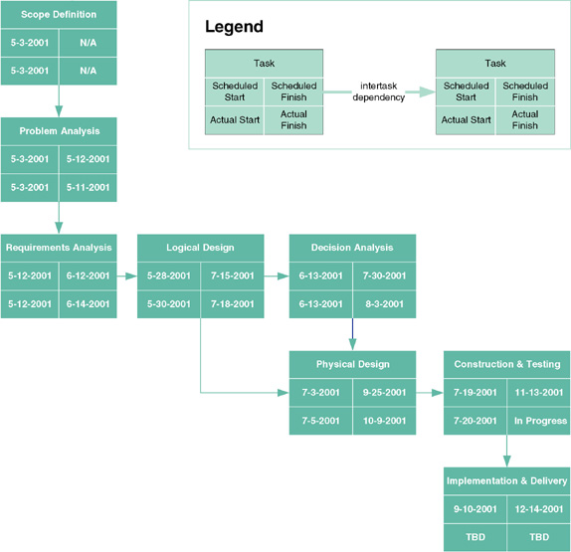
PERT Chart
Notes:
Teaching Notes
PERT was developed to make clear the interdependence between project tasks before those tasks are scheduled. The boxes represent project tasks (we used phases from Chapter 3). (The content of the boxes can be adjusted to show various project attributes such as schedule and actual start and finish times.) The arrows indicate that one task is dependent upon the start or completion of another task.
The “data” recorded in the nodes on a PERT chart vary with project management software tools. Microsoft Project supports different combinations of data in the nodes.
See the comments at the beginning of the IG for an explanation of the “activity on the node: convention.

Slide 13
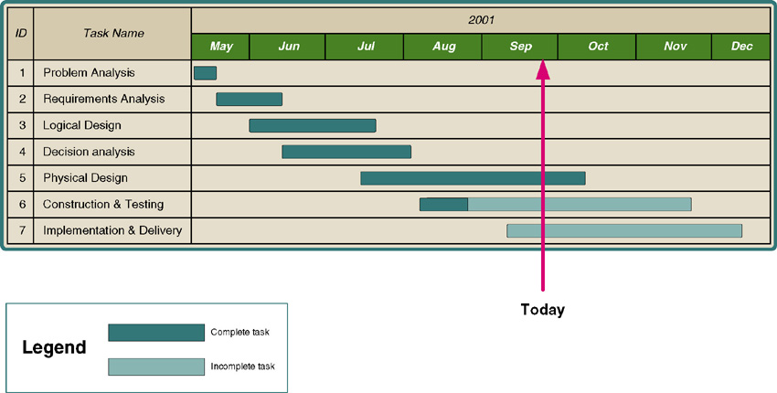
Gantt Chart
Notes:
Teaching Notes
Gantt charts offer the advantage of clearly showing overlapping tasks, that is, tasks that can be performed at the same time. The bars can be shaded to clearly indicate percentage completion and project progress. The figure demonstrates which phases are ahead and behind schedule at a glance. The popularity of Gantt charts stems from their simplicity—they are easy to learn, read, prepare, and use.

Slide 14
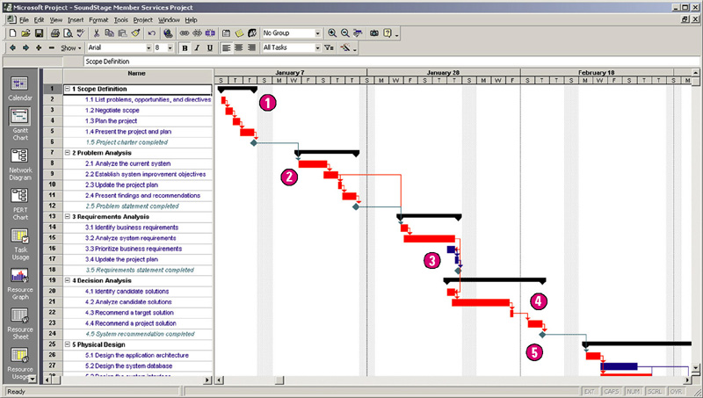
Microsoft Project Gantt Chart
Notes:
Teaching Notes
The previous slide’s Gantt chart was built using Microsoft Visio. This one was built with Microsoft Project.
Emphasize that Gantt charts can also show milestones and intertask dependencies.

Slide 15
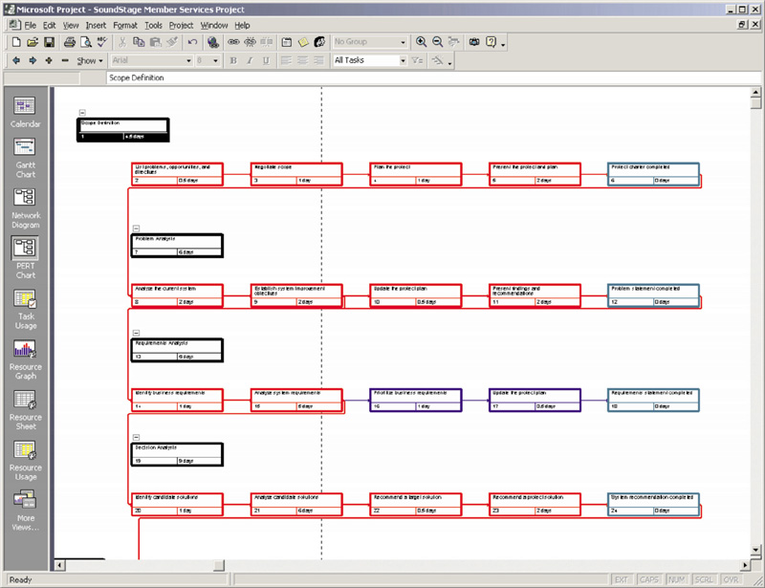
Microsoft Project PERT Chart
Notes:
Teaching Notes
Notice that summary tasks do not have dependencies and are represented in black. The authors chose to use red to depict critical tasks (discussed later in the chapter. Milestones are depicted in teal.

Slide 16
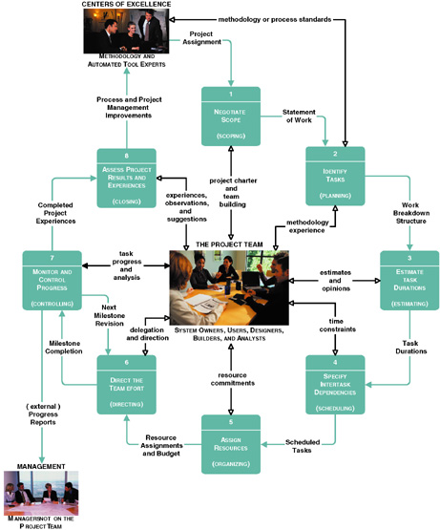
Project Management Life Cycle
Notes:
Teaching Notes
This slide becomes the organizing model for the rest of the chapter.

Slide 17
Joint Project Planning Strategy
Joint project planning (JPP) – a strategy in which all stakeholders attend an intensive workshop aimed at reaching consensus on project decisions.
Notes:
No additional notes.

Slide 18
Activity 1 – Negotiate Scope
Scope – the boundaries of a project – the areas of a business that a project may (or may not) address. Includes answers to five basic questions:
Product
Quality
Time
Cost
Resources
Statement of work – a narrative description of the work to be performed as part of a project. Common synonyms include scope statement, project definition, project overview, and document of understanding.
Notes:
Teaching Notes
In consulting engagements, the statement of work has become a commonly used contract between the consultant and client. But the approach works equally well for internal system development projects to establish a contract between business management and the project manager and team.

Slide 19
Statement of Work
I. Purpose
II. Background
A. Problem, opportunity, or directive statement
B. History leading to project request
C. Project goal and objectives
D. Product description
III. Scope
A. Stakeholders
B. Data
C. Processes
D. Locations
IV. Project Approach
A. Route
B. Deliverables
V. Managerial Approach
A. Team building considerations
B. Manager and experience
C. Training requirements
(continued)
Notice the use of information system building blocks
Notes:
No additional notes.

Slide 20
Statement of Work (concluded)
V. Managerial Approach (continued)
D. Meeting schedules
E. Reporting methods and frequency
F. Conflict management
G. Scope management
VI. Constraints
A. Start date
B. Deadlines
C. Budget
D. Technology
VII. Ballpark Estimates
A. Schedule
B. Budget
VIII. Conditions of Satisfaction
A. Success criteria
B. Assumptions
C. Risks
IX. Appendices
Notes:
No additional notes.

Slide 21
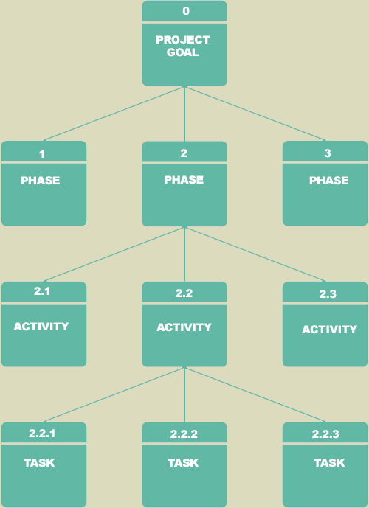
Activity 2 – Identify Tasks
Work breakdown structure (WBS) – a graphical tool used to depict the hierarchical decomposition of the project into phases, activities, and tasks.
Milestone – an event signifying the completion of a major project deliverable.
Notes:
Conversion Notes
For the seventh edition the figure definitions and the figure were combined on one slide.
Teaching Notes
A WBS may or may not specify milestones.
Tasks must be broken down to a level at which they are manageable. Some experts suggest that a task must be accomplished within 40 working hours or further subdivided into tasks until they can.
Note the numbering scheme Phase 2, Activity 2.1 (activity 1 of phase 2), Task 2.2.3 (task 3 of activity 2 of phase 2)
An important thing to note is that WBSs represent a form of outlining and decomposition.
As a rule of thumb, a task is broken down to two or more subtasks, but no task should have more than six subtasks.

Slide 22
Activity 3 – Estimate Task Durations
Elapsed time takes into consideration:
Efficiency - no worker performs at 100% efficiency
Coffee breaks, lunch, e-mail, etc.
Estimate of 75% is common
Interruptions
Phone calls, visitors, etc.
10-50%
Notes:
Conversion Notes
This is a new slide in the seventh edition.

Slide 23
Activity 3 – Estimate Task Durations
1. Estimate the minimum amount of time it would take to perform the task – the optimistic duration (OD).
2. Estimate the maximum amount of time it would take to perform the task – the pessimistic duration (PD).
3. Estimate the expected duration (ED) that will be needed to perform the task.
4. Calculate a weighted average of the most likely duration (D) as follows:
D = (1 x OD) + (4 x ED) + (1 x PD) 6
OD
ED
PD
3.33 days = (1 x 2 days) + (4 x 3 days) + (1 x 6 days) 6
Notes:
Teaching Notes
Recognize that the chapter demonstrated only one approach to estimating. The terminology used is consistent with that of Microsoft Project.
Project actually allows the project manager to modify this formula to reflect his or her personal experience.

Slide 24
Activity 4 – Specify Intertask Dependencies
Finish-to-start (FS)—The finish of one task triggers the start of another task.
Start-to-start (SS)—The start of one task triggers the start of another task.
Finish-to-finish (FF)—Two tasks must finish at the same time.
Start-to-finish (SF)—The start of one task signifies the finish of another task.
Notes:
Teaching Notes
The default in most project management software packages is “finish-to-start.” The other options are provided to improve scheduling flexibility based on intertask dependency.

Slide 25
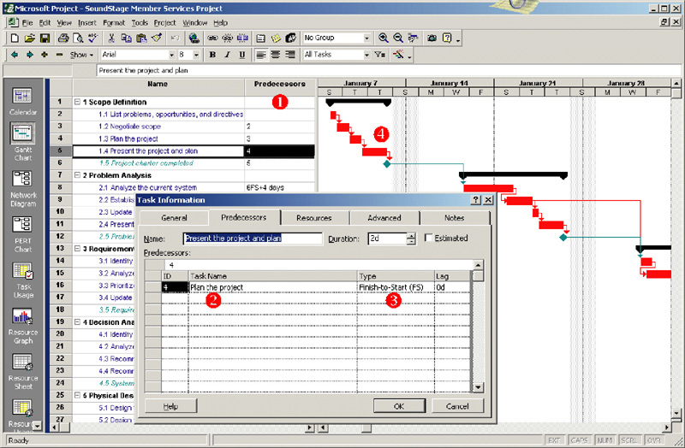
Entering Intertask Dependencies
Notes:
No additional notes.

Slide 26
Scheduling Strategies
Forward scheduling – a project scheduling approach that establishes a project start date and then schedules forward from that date.
Reverse scheduling – a project scheduling strategy that establishes a project deadline and then schedules backward from that date.
Notes:
Teaching Notes
In the event that the project manager is given a deadline to meet, reverse scheduling strategy is ideal.

Slide 27
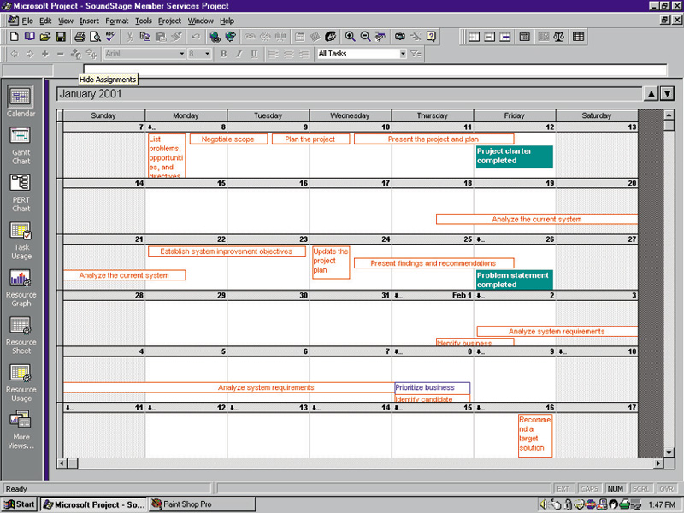
A Project Schedule in Calendar View
Notes:
No additional notes.

Slide 28
Activity 5 – Assign Resources
People – includes all system owners, users, analysts, designers, builders, external agents, and clerical help involved in the project in any way.
Services – includes services such as a quality review that may be charged on a per use basis.
Facilities and equipment – includes all rooms and technology that will be needed to complete the project.
Supplies and materials – everything from pencils, paper, notebooks to toner cartridges, and so on.
Money – includes a translation of all of the above into budgeted dollars!
Notes:
Teaching Notes
Before resources can be assigned to a project/task, the analyst must obtain the various stakeholders’ commitment of those resources.

Slide 29
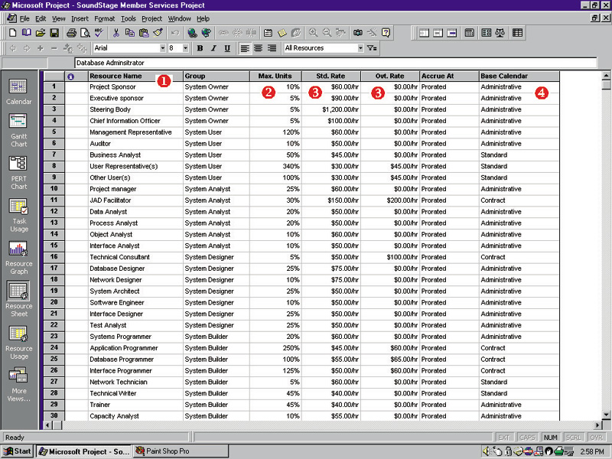
Defining Project Resources
Notes:
No additional notes.

Slide 30
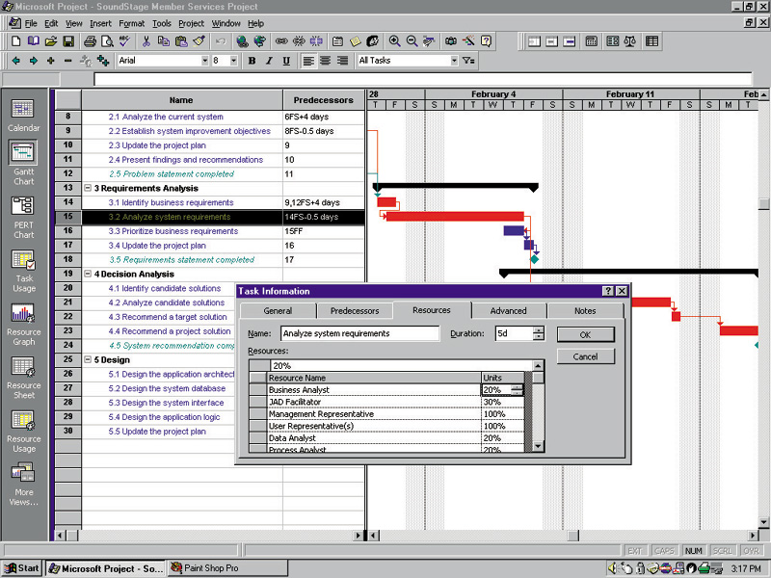
Assigning Project Resources
Notes:
No additional notes.

Slide 31
Assigning People to Tasks
Recruit talented, highly motivated people
Select the best task for each person
Promote team harmony
Plan for the future
Keep the team size small
Notes:
Conversion Notes
This is a new slide for the seventh edition.

Slide 32
Resource Leveling
Resource leveling – a strategy for correcting resource over-allocations.
Two techniques for resource leveling:
task delaying
task splitting
Notes:
Teaching Notes
It should be noted that resource leveling will be an ongoing activity since the schedule and resource assignments are likely to change over the course of a project.

Slide 33
Task Splitting and Task Delaying
Critical path – the sequence of dependent tasks that determines the earliest possible completion date of the project.
Tasks on the critical path cannot be delayed without delaying the entire project. Critical tasks can only be split.
Slack time – the amount of delay that can be tolerated between the starting time and completion time of a task without causing a delay in the completion date of the entire project.
Tasks that have slack time can be delayed to achieve resource leveling
Notes:
Teaching Notes
You may want to refer to Figure 4-18 to illustrate the concepts of critical path and slack time.
The reason the critical path sequence determines the earliest possible completion date is that those tasks have the largest sum of most likely durations.

Slide 34
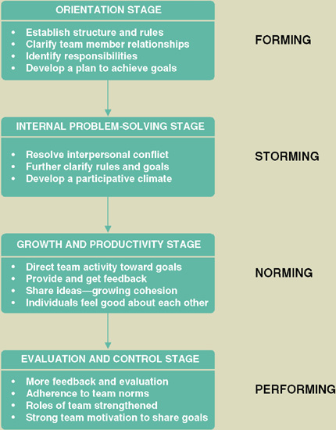
Activity 6 – Direct the Team Effort
Supervision resources
The Deadline: A Novel about Project Management
The People Side of Systems
The One Minute Manager
The One Minute Manager Meets the Monkey
Stages of Team Maturity (see figure to the right)
Notes:
No additional notes.

Slide 35
10 Hints for Project Leadership
Be Consistent.
Provide Support.
Don’t Make Promises You Can’t Keep.
Praise in Public; Criticize in Private.
Be Aware of Morale Danger Points.
Set Realistic Deadlines.
Set Perceivable Targets.
Explain and Show, Rather Than Do.
Don’t Rely on Just Status Reports.
Encourage a Good Team Spirit.
Notes:
No additional notes.

Slide 36
Activity 7 – Monitor and Control Progress
Progress reporting
Change management
Expectations management
Schedule adjustments—critical path analysis (CPA)
Notes:
No additional notes.

Slide 37
Sample Outline for Progress Report
I. Cover Page
A. Project name or identification
B. Project manager
C. Date or report
II. Summary of progress
A. Schedule analysis
B. Budget analysis
C. Scope analysis (changes that may have an impact on future progress)
D. Process analysis (problems encountered with strategy or methodology)
E. Gantt progress chart(s)
III. Activity analysis
A. Tasks completed since last report
B. Current tasks and deliverables
C. Short term future tasks and deliverables
(continued)
Notes:
Teaching Notes
Emphasize that this is merely a sample. Encourage students to consider that many organizations have their own reporting standards to report project progress. In addition, many methodologies provide templates for various reporting needs.

Slide 38
Sample Outline for a Progress Report (concluded)
IV. Previous problems and issues
A. Action item and status
B. New or revised action items
1. Recommendation
2. Assignment of responsibility
3. Deadline
V. New problems and issues
A. Problems
(actual or anticipated)
B. Issues
(actual or anticipated)
C. Possible solutions
1. Recommendation
2. Assignment of responsibility
3. Deadline
VI. Attachments
(include relevant printouts from project management software)
Notes:
No additional notes.

Slide 39
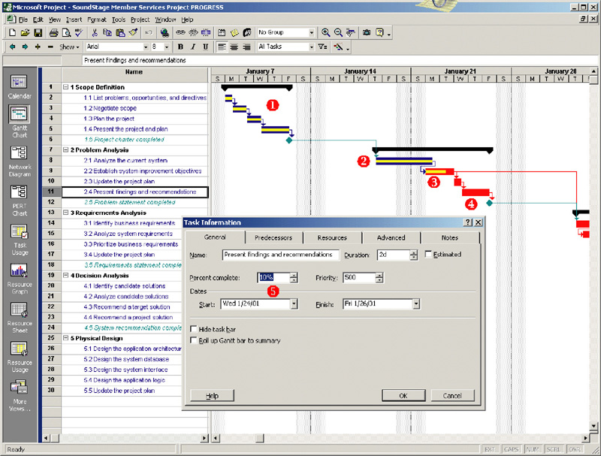
Progress Reporting on a Gantt Chart
Notes:
No additional notes.

Slide 40
Change Management
Change management – a formal strategy in which a process is established to facilitate changes that occur during a project.
Changes can be the result of various events and factors including:
An omission in defining initial scope
A misunderstanding of the initial scope
An external event such as government regulations that create new requirements
Organizational changes
Availability of better technology
Shifts in planned technology that force changes to the business organization, culture, and/or processes
Management’s desire to have the system do more
Reduced funding for project or imposition of an earlier deadline.
Notes:
No additional notes.

Slide 41
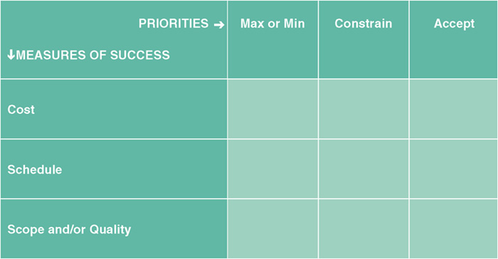
Expectations Management
Expectations management matrix – a tool used to understand the dynamics and impact of changing the parameters of a project.
The most important
The second most important
The least important
Can have only one X in each row and each column
Notes:
Teaching Notes
We find this to be a useful teaching tool both with students and clients. One can have only one main goal. The second is accepted as a constraint. Given the other two, the third just has to be accepted. To make one more important is to make another one less important.

Slide 42
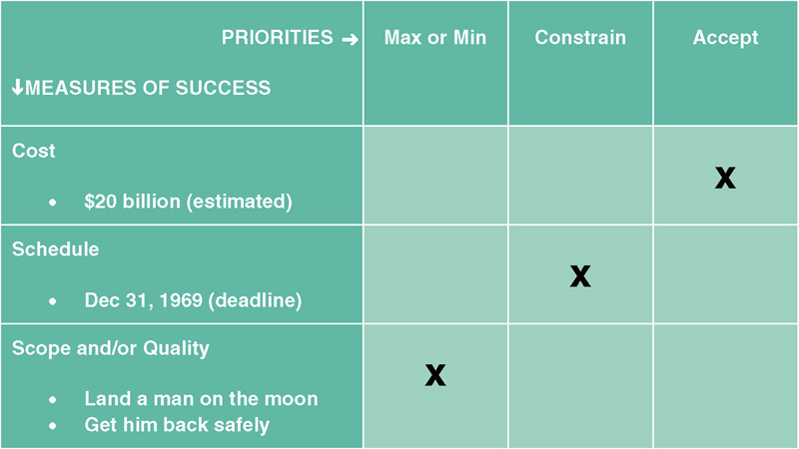
Lunar Project Expectations Management
Notes:
Teaching Notes
In the Apollo project, given that scope/quality was the number one goal and that schedule was the constraint, NASA and the U.S. government (the system owners) were prepared to accept whatever cost was required.

Slide 43
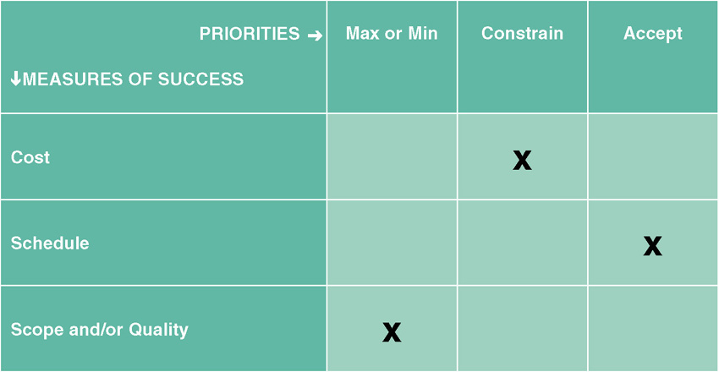
Typical, Initial Expectations for a Project
Notes:
Teaching Notes
For many system development projects, scope/quality is the first concern and cost is the constraining factor. Users would then have to accept whatever schedule allowed that scope to be delivered within that cost.

Slide 44
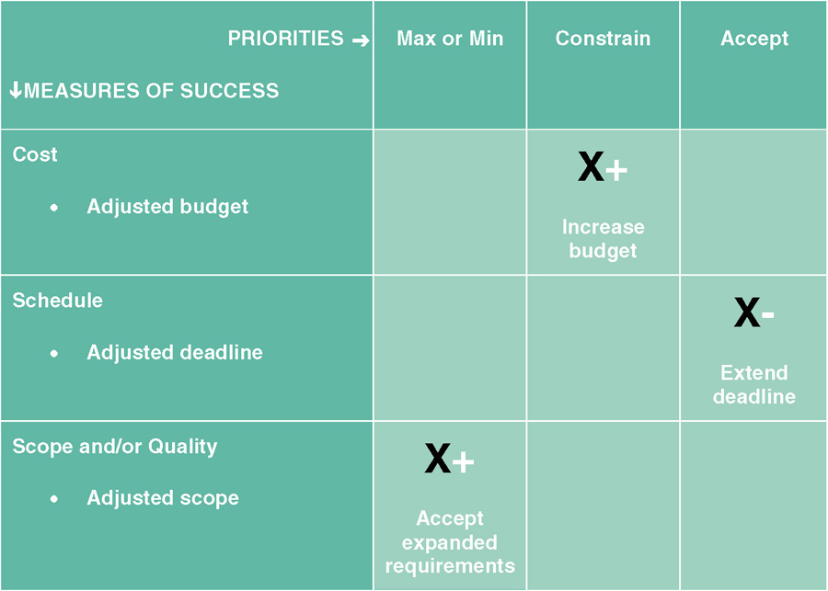
Adjusting Expectations
Notes:
Teaching Notes
This diagram illustrates what happens when the scope increases. Generally if the new scope is the measure of success for the project, then either the deadline must be extended or more budget added to the project or both. Another possibility would be that other system requirements can be put off until another version.

Slide 45
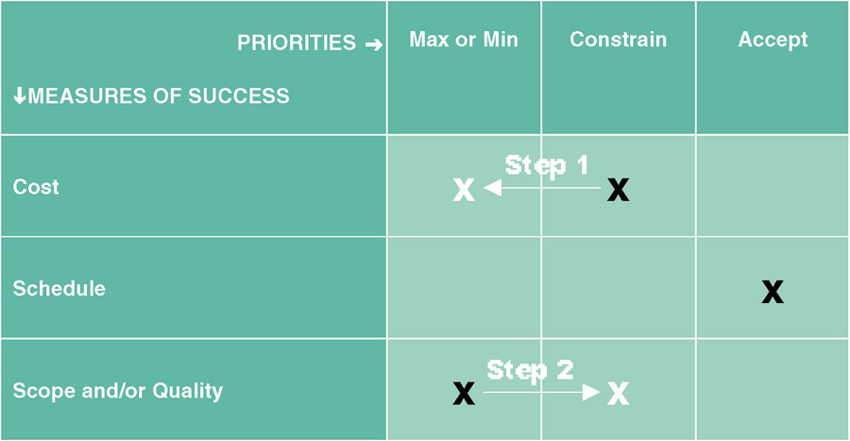
Changing Priorities
Notes:
Teaching Notes
This illustrates that only one factor can be the measure of success. If scope/quality is the measure then cost cannot be more than a constraint and vice-versa.

Slide 46
Schedule Adjustments - Critical Path Analysis
Using intertask dependencies, determine every possible path through the project.
For each path, sum the durations of all tasks in the path.
The path with the longest total duration is the critical path.
The critical path is the sequence of tasks with the largest sum of most likely durations. The critical path determines the earliest completion date of the project.
The slack time for any non-critical task is the amount of delay that can be tolerated between starting and completion time of a task without causing a delay in the entire project.
Notes:
Teaching Notes
The explanation of identifying the critical path is a simplified description. Identifying the critical path for large complex projects with many paths can be quite challenging. There are other approaches that can be used to identify the critical path (see Wysocki et al.).

Slide 47
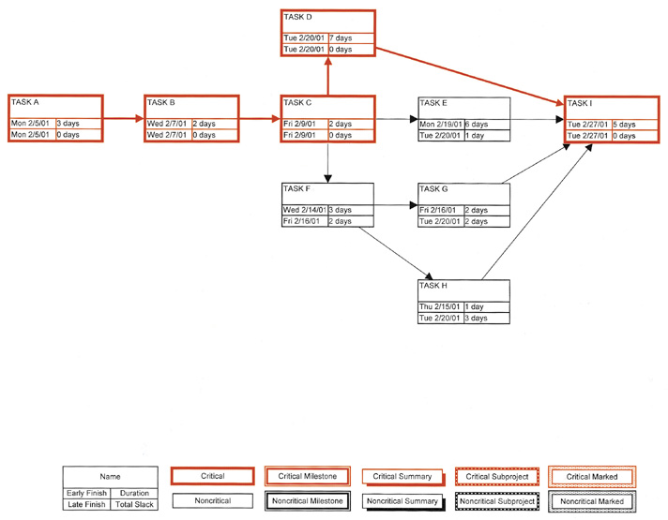
Critical Path Analysis
Notes:
Teaching Notes
The critical path is shown in red. It is critical because it is the longest path from beginning to end. If any task along the critical path slips, the project slips.

Slide 48
Activity 8 – Assess Project Results and Experiences
Did the final product meet or exceed user expectations?
Why or why not?
Did the project come in on schedule?
Why or why not?
Did the project come in under budget?
Why or why not?
Notes:
No additional notes.

