Slide 1
Clinical Documentation Requirements
SAN JOSÉ STATE UNIVERSITY
The Valley Foundation School of Nursing
Notes:
Hello and welcome to the valley foundation School of Nursing at San Jose State University. I plan to review with you the clinical documentation requirements.

Slide 2
Questions
Please contact:
Beatriz Porter
Castle Branch Compliance Coordinator
Beatriz.Porter@sjsu.edu
408-924-3130
Notes:
For questions on the clinical documentation requirements, please contact me by email. I’ll also have this information up at the end if you need more time to take it down.

Slide 3
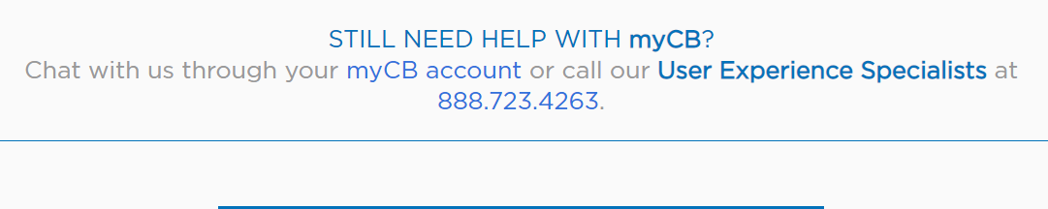
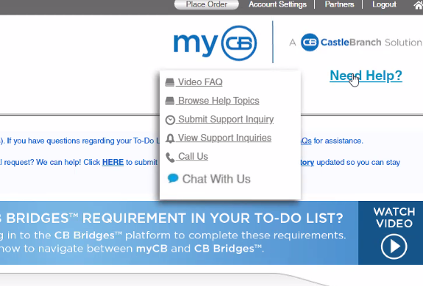
Need tech support?
https://discover.castlebranch.com/contact-us/
Notes:
The best contact for CastleBranch technical assistance is the vendor. They can help with any issues with uploading documents. You can call them and there is also an option to chat with them by logging into your Castle Branch Account. For more information you can visit this page.

Slide 4
Castle Branch Student Tracker
Navigate to the Castle Branch (CB) website: https://portal.castlebranch.com/NU12
Pick the appropriate package for your program.
Incoming BSN Semester 1 students: NU13
Incoming RN to BSN & ICCP Students: NU14
Graduate/Masters: NU36, and select the package for Educator or FNP
New Student Packages = $135.00
Includes: Drug Screen / Background Check/ Compliance Tracker
Deadlines to submit documentation will be given in the instructions.
Current deadlines are Jan 1 & Aug 1 to prevent items from expiring mid-semester.
Notes:
By now most of you have created your Castle Branch Accounts and completed your compliance documentation. A couple of key things I want to call your attention to: The deadlines for Castle branch renewals is currently January 1st for Spring and August 1st for Fall. This deadline is for the bachelor program and the Advanced Placement RN to BSN programs. Flu shots are due by October 1 and must be updated yearly.

Slide 5
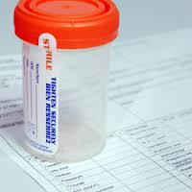
Entrance Requirements
***
IMPORTANT: Notify the Director of the Nursing Program ASAP if; you have concerns regarding your initial background check and; if there are any changes to your drug screen, background check, or drivers license status during the program.
Drug Screening
Follow instructions on CB website for submitting a sample for drug screening.
Drug screens may need to be updated per clinical site requirements – clinical instructors will advise at site-orientation.
Background Checks
Follow instructions on CB to initiate the background check.
Background Check may need to be updated per clinical site requirements – clinical instructors will advise at site-orientation.
Notes:
A clear drug screen and background check is required upon entrance to the program. Depending on the hospital agencies, you're assigned to for clinical an updated drug screen and/or background check may be required as you progress through the program.
If you have any changes to your drug screen, background check, or driver’s license status during your time in the program, you must notify the castle branch compliance coordinator and the director of the school of nursing as soon as possible.
Please be mindful of the company you keep since those we spend time with influence us. If you chose to consume alcoholic beverages, plan ahead and always have a designated driver. You have worked very hard to get here and we want to support you to be successful and this is why we must cover this information so that you can prepare ahead to be safe, to keep others safe, and to be responsible as a professional student nurse.

Slide 6
The Affordable Care Act mandates that all citizens have qualified medical insurance.
IF YOU DON’T ALREADY HAVE HEALTH INSURANCE: Go to Covered California website for insurance coverage options
www.coveredca.com
Upload a copy of your Health Insurance card to CB
Your name must be on the card – or support documentation is needed.
Upload new cards when changes in coverage occur.
Insurance must include 24/7 hospital stay and emergency room coverage (SJSU Health Center coverage does not count).
Notes:
Health insurance is required, while in the program. If you need to apply for health insurance, you can visit www.coveredca.com. Your health insurance card must be uploaded to Castle branch. Your name must be on the card and if your name is not on the card, additional support documentation in the form of a letter verifying your coverage is required. Please upload new cards when changes in coverage occur. This is required so that the latest and most current card is in Castle branch. Insurance must include coverage for 24/7 hospital stay and emergency room coverage.

Slide 7
Health Statement
This form is a statement of your health status and clears you for participation in clinicals
Download Health Statement form from CastleBranch
Also available here: https://www.sjsu.edu/nursing/docs/2018%20health%20Statement.docx
The provided Health Statement form must be signed by a primary care provider (NP, MD, etc.).
If you experience a change in health status during the program:
ASAP after a change in health status, notify: Castle Branch Compliance Coordinator
To return to coursework after a health-related absence an updated, signed Health Statement form is required from an appropriate specialist (OB for obstetrics issues, Mental Health for MH issues, Osteo for bone issues, etc.)
Common changes to health status may include, but are not limited to:
injury, mental health concern, surgery, vision & hearing changes, etc.
Notes:
The health statement must be signed by your primary health care provider. If you have a change in health status, please contact your provider to update this form and notify your compliance coordinator. Examples of changes in health status may include an injury, mental health concern, surgery, vision or hearing changes.

Slide 8
Cardio-Pulmonary Resuscitation (CPR)
CPR certification is required annually
All nursing students (including RN-BSN students) must annually renew CPR training.
Obtain Certification during breaks (ie, between semesters): Dec 10-Dec 31 or June 1-July 31
CPR can not expire during the semester
CastleBranch Requirements:
Must be an American Heart Association (AHA) CPR course
Basic Life Support (BLS) for Healthcare Providers: this includes Infant, Child & Adult, and AED training
Online-only CPR classes are NOT accepted.
Notes:
CPR is required and it must be renewed annually. CPR cannot expire during the semester. It must be taken with an American Heart Association approved training provider and no online classes are accepted currently
The cards look like this. Some agencies are moving to a certificate. I'll show you what that looks like in a moment, please note that the card will have an expiration date for a two-year period. However, it must still be updated yearly.

Slide 9
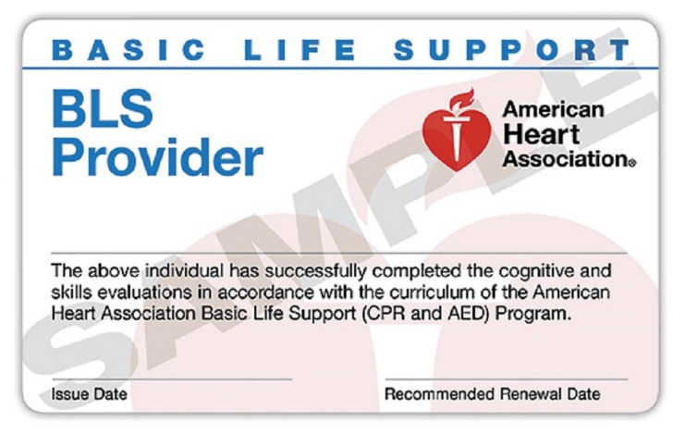
CPR (continued)
CPR course must be taken with an American Heart Association (AHA) approved course provider.
This will be indicated on the back of the card or front of the e-card.
IMPORTANT: Confirm you have the right course when booking.
You may receive a card that looks like this (🡪) with an issue date and expiration date. While the cards are issued for 2 year periods, all students, while in nursing school, must renew CPR certification every year.
Notes:
CPR course must be taken with an American Heart Association (AHA) approved course provider. This will be indicated on the back of the card or front of the e-card. Please confirm you have the right course when booking.

Slide 10
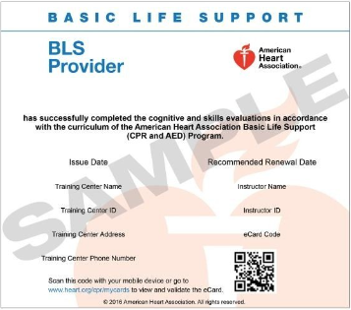
CPR (continued)
E-cards are now being issued by many agencies.
Notes:
E-cards are now being issued by many agencies.

Slide 11
CPR (continued) RN to BSN and Graduate Students
ACLS and PALS
If you have current ACLS and PALS certifications, which do not expire during the academic year – you may use those certifications instead of Basic Life Support (BLS).
You must have both, and must still follow the annual renewal requirement.
ACLS and PALS must be taken with an American Heart Association (AHA) approved course provider or equivalent.
Certifications can not expire during the semester.
Notes:
For Advanced Placement RN to BSN and graduate students only if you have a current a CLS and PAL certification that does not expire in the academic year. You may use that in place of BLS
But you need to have both certifications and they must be taken with American Heart Association approved course provider, they cannot expire during the semester and must be renewed annually.

Slide 12
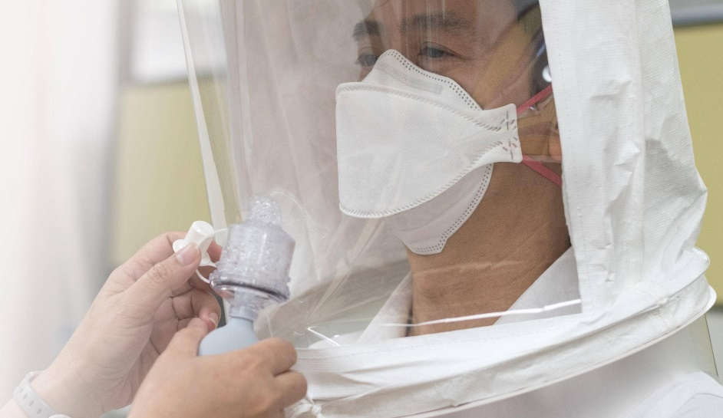
Fit Testing
Fit testing (respiratory mask fitting) may be required by your clinical site – you will be informed prior to beginning that clinical.
You will be given information prior to each semester for scheduling a fit test.
Valid for 1 year (or two semesters).
Notes:
Fit testing may be required by your clinical agency. For information on how to schedule your FIT test, please check with the SON office. Fit testing is valid for one year.

Slide 13
Flu Shots
Updated, annual Flu Immunization (flu shot) is due by October 1st
Usually available between late August thru Sept.
Declination form: https://www.sjsu.edu/nursing/docs/2018%20Flu%20Immunization%20Declination%20Form.docx
Hospital policies regarding declination of the flu shot require students to wear masks while on site – not all clinical site will accept a declination form.
Notes:
Flu shots are usually available between late August through September and are due by October 1. If you must decline the flu shot, a declination form is required. Hospital policies regarding declination of the flu shot require students to wear masks while on site.

Slide 14
Quantiferon Tuberculosis (TB) Test
Due annually, and must be obtained during between semester (Dec 10-Dec 31; or June 1-July31)
Must not expire during the semester (while in the clinical setting).
Upload lab results to CastleBranch.
Not accepted: Tuberculin Skin Testing (TST).
Notes:
The Quantiferon TB test is due annually. Please be sure that your lab results include the data collection or date of the test and that’s needed to set the expiration for the next time you must renew. We do not accept TB skin testing.

Slide 15
TB (continued) History of Positive TB
If you have a history of a positive TB test (also called Latent TB)…
No Quantiferon Blood Test required – instead, proceed with
Chest x-ray results from within 12 months prior to starting the nursing program
does not need renewal after initial results provided
TB Assessment form (in CB, or accessible here: https://www.sjsu.edu/nursing/docs/TB_annual_questionnaire.pdf
Form needs to be filled out by a primary care provider (NP, MD, ETC.).
RENEWAL: TB Assessment form (only) must be filled out and uploaded annually.
Notes:
If you've ever had a history of a positive TB test, you do not need a chronic around blood test instead the requirements are as follows. You will need to complete a chest x ray within 12 months of starting the nursing program. In addition to submitting a copy of the chest x ray report, you will also submit a TB assessment form, which can be found at this link. This needs to be filled out and signed by your primary care provider.
After your initial submission of the chest x ray and TB assessment form, so long as you remain symptom free, when you renew next you will submit only the TB assessment form. There is no need to repeat the chest x ray after you've submitted your initial chest x ray. If you remain symptom free.

Slide 16
Vaccinations / Immunization Positive titers* preferred
*A positive titer test indicates active immunity
Measles, Mumps, & Rubella (MMR)
Positive titer
or
2 previous vaccinations
Hepatitis B
Reactive Titer Required
and
3 previous vaccinations
If Non-Reactive titers
Booster vaccinations
(Note: Hep B series takes 6 months to revaccinate)
Varicella (Chicken Pox)
Positive titer
or
2 previous vaccinations
Re-titer is required 4 weeks (not earlier) after the last booster
All titer and immunization requests can be ordered by: a primary care provider or the SJSU Health Center.
Notes:
This slide outlines two requirements for measles, mumps, and rubella hepatitis B and varicella. For MMR a positive tighter or two previous vaccinations is required. For hepatitis B a reactive tighter and three previous vaccinations is required if you have a non-reactive tighter. You will be prompted by castle branch to submit a repeat of the hepatitis B series. Please note that the hepatitis B series may take up to six months. Because of this, you'll need to upload each shot as you receive them and plan to obtain these as soon as possible, if necessary. For varicella, you must submit either a positive tighter or two previous vaccinations.

Slide 17
Are you immune? (Titers)
Titers are not vaccinations – a titer test is a blood test to check for immune response as a result of earlier vaccinations
Titers can test for…
Measles, Mumps and Rubella (MMR)
Varicella (Chicken pox)
Hepatitis B
Requires a single blood draw to test for all three (MMR, varicella, and HepB)
Lab results must be uploaded to CastleBranch
Refer to Grid (following slide) for guidance related to results.
Notes:
Titers are always preferred because they provide information on your immune status. They require a blood draw, and a copy the lab results uploaded to Castle branch.

Slide 18
Proof of Vaccination Tdap Tetanus, Diphtheria, and Pertussis
Info is on your yellow immunization or immigration card
Needed: proof of TDaP vaccination received after 19 years old
Td booster every 10 years thereafter*
*Requirements are subject to change when a community outbreak occurs.
Notes:
For T dap. You must provide proof of a Tdap vaccination after age 19. After submission of your initial Tdap vaccination, a booster is required every 10 years. The booster may be teed up or it may be the TD booster. Please note that requirements are subject to change. When a community outbreak occurs. A Tdap vaccination is always the recommended option upon renewal because it includes the vaccination for pertussis or whooping cough. This is important as we’ve had whooping cough outbreaks in our area every few years.

Slide 19
Vaccination Requirements
Vaccination | Requirements | Titer/Results | Follow up for Negative or Borderline immunity:
Hep B | Proof of (3) vaccinations and (+) Titer | (+) Positive titer- No further action required or If Non- reactive→→ | Non Reactive titer – Proof of (3) previous vaccinations is required & revaccinate entire series of (3) vaccinations (or PCP recommendations) & re-titer after 4 weeks (or PCP recommendations) Re-titer Non Reactive– No further action required
MMR | Proof of (2) vaccinations after 2 years of age, and administered at least 28 days apart or (+) Titer | (+) Positive titer- No further action required or If Non- reactive→→ | Negative titer – Proof of (2) MMR vaccinations in childhood are required & (1 or 2) MMR vaccination booster(s) should be obtained ( or PCP recommendation) No re-titer is required
Varicella | Proof of (2) vaccinations or (+) titer | (+) Positive titer- No further action required or If Non- reactive→→ | Negative titer – Proof of (2) previous vaccinations & (1 or 2) Varicella booster(s) (or PCP recommendations), & No re-titer is required
Tdap | Proof of current vaccination Tdap must be within 10 years of starting the program, and administered after age 19 | None | Td Every 10 years booster, unless outbreak occurs (new, direct instructions will be given).
TB Screening | Quantiferon Blood Test | RESULTS If Negative results – no further action required | Positive results– Obtain chest x-ray & TB Assessment signed by PCP for clearance. Annual TB Assessment required yearly ( no testing required)
Notes:
You can refer to this grid. For more information on vaccination requirements and you may also refer to the specific instructions for each requirement and Castle branch.

Slide 20
NSO Liability (Malpractice) Insurance
Details about obtaining NSO liability insurance:
https://www.sjsu.edu/nursing/docs/NSO%20Malpractice%20Notice%202015.pdf
Insurance must be renewed annually and must not expire during the academic year (during clinical placement).
The Certificate of Insurance is uploaded to CastleBranch.
Cost is approximately
BSN (pre licensure): ~$27
RN-BSN/Masters (post licensure): ~$104
Notes:
Malpractice insurance from NSO is required. For information on how to obtain this, please visit this link. This insurance must be renewed annually and must not expire during the academic year, the certificate of insurance is uploaded to Castle branch.

Slide 21
COVID-19
See University Policy:
Per the statement by the California State University (CSU) Chancellor’s Office requiring vaccinations for all students accessing campus facilities, The Valley Foundation School of Nursing will adhere to San José State University vaccination guidelines and uphold the Chancellor’s Office Healthcare Agency Clinical Placement Requirements.
Everyone must have a complete COVID-19 vaccination cycle and booster.
Proof of vaccination + booster is required in CB in addition to other SJSU requirements

Slide 22
Questions
Please contact:
Beatriz Porter
Castle Branch Compliance Coordinator
Beatriz.Porter@sjsu.edu
408-924-3130
Notes:
That concludes our slides again if you have additional questions, please reach out to your castle branch coordinator. For information on technical support, you can contact castle branch by phone. Again, thank you for your time and welcome to the valley foundation School of Nursing.

Slide 23
Updated 4/26/2023
By: Dr. Lisa Rauch

