Slide 1
The Bible and Its Influence Chapter 10: “The Kingdom Falls”
Kristen and Sophia

Slide 2
Solomon and David
Bathsheba pleas on behalf of her son, Solomon, and forestalls the civil war
David anoints Solomon as David’s heir
David reminds Solomon of the covenant that his powers derive from
“Be strong, be courageous, and keep the charge of the Lord your God, walking in his ways and keeping his statutes, his commandments, his ordinances, and his testimonies…” (1 Kings 2:2-3)

Slide 3
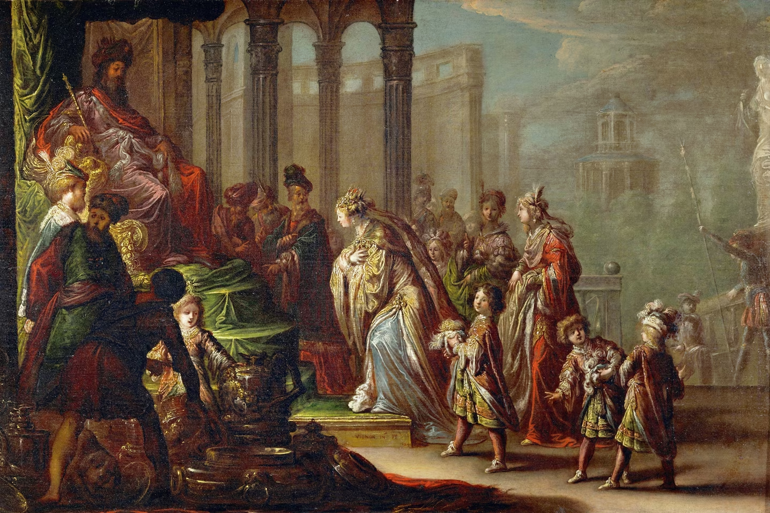
Solomon’s Gift
God appears to Solomon in a dream, telling him that whatever he asks for, will be his. Solomon requests wisdom, and God grants it to him
Wisdom becomes Solomon’s most memorable characteristic
Today, a person who makes a wise decision is called “a Solomon” or “like Solomon”
Under Solomon’s rule, the kingdom was peaceful and prosperous at first
Solomon builds the First Temple
National Geographic, https://www.nationalgeographic.com/culture/article/story-king-solomon-wise-temple

Slide 4
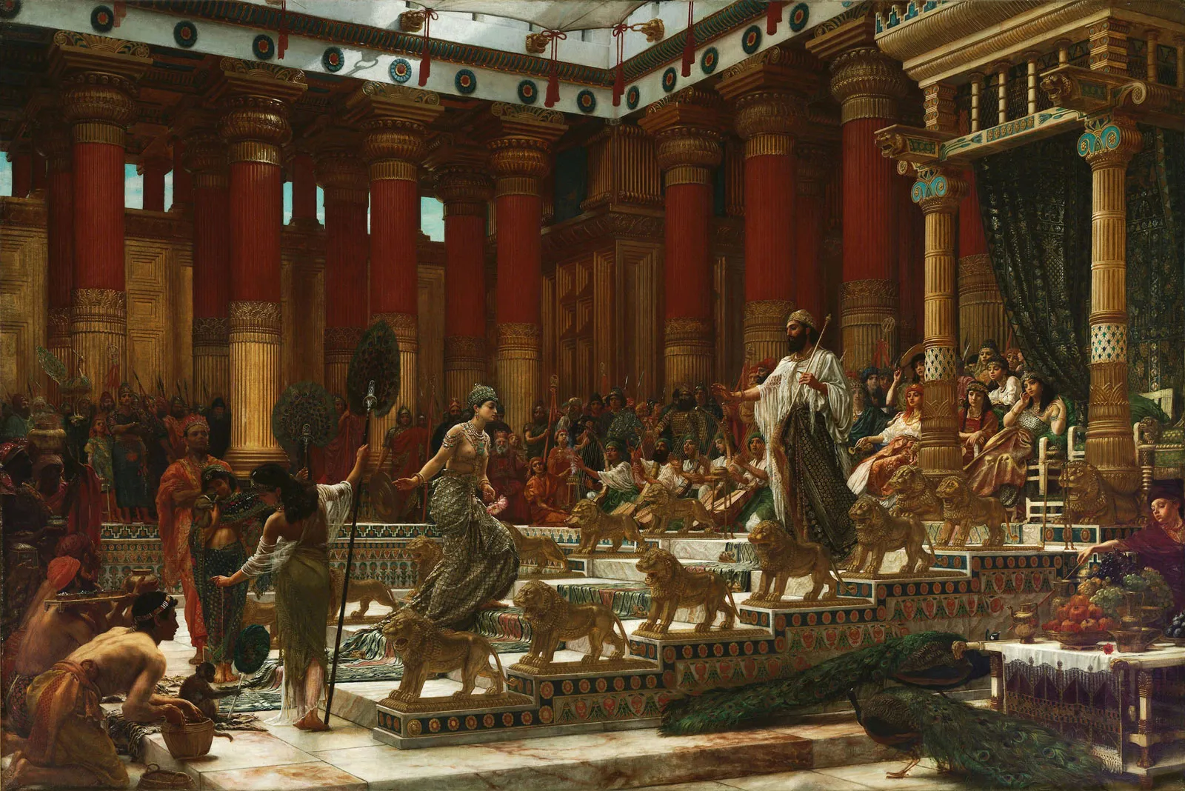
Queen of Sheba
“One of the Bible’s most compelling and mysterious characters” (B.I., 94)
Notable for being a non-Israelite woman in power, who still respects God
Associated with sub-Saharan Africa
Features prominently in The Kebra Nagast, a 14th-century Ethiopian epic
Edward Poynter, The Visit of the Queen of Sheba to King Solomon, 1890, https://www.britannica.com/biography/Queen-of-Sheba

Slide 5
“Now there was a great wind, so strong that it was splitting mountains and breaking rocks in pieces before the Lorn, but the Lord was not in the wind; and after the wind an earthquake, but the Lord was not in the earthquake; and after the earthquake a fire, but the Lord was not in the fire; and after the fire a sound of sheer silence.” (1 Kings 19:11-12)

Slide 6
Elijah
He “understood that zeal and pyrotechnics were not enough to educate others”
There is an oratorio by Ludwig Mendelssohn about his story

Slide 7
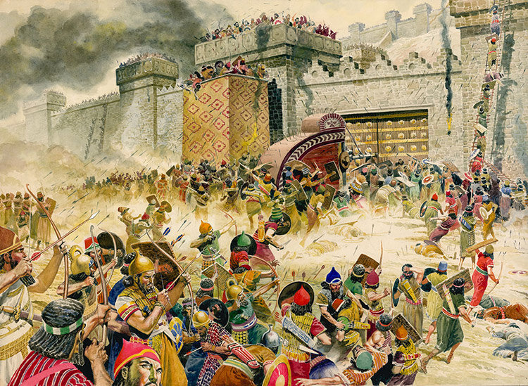
The Final Fall
Destruction of David’s kingdom began with the corruption within, and slowly moved on to domination from the outside
People ignored the prophets’ warnings; they had forgotten about the painful consequences that come with opposing/ violating the covenant
Israel was the first to succumb, king Hoshea attempted to revolt
Northern kingdom of Israel was conquered, and many members were carried off into exile
Southern kingdom Judah, was next to succumb
Solomon’s temple was looted then burned to the ground, and people were carried into captivity in Babylon
The Not So Innocents Abroad, https://www.thenotsoinnocentsabroad.com/blog/the-fall-of-israel-in-the-old-testament-explained

Slide 8
“The Lord rejected all the descendants of Israel; he punished them and gave them into the hand of the plunderers, until he had banished them from his presence. When he had torn Israel from the house of David… Israel was exiled from their own land to Assyria until this day.” (2 Kings 17:20-23)

