Slide 1
The Bible and Its Influence
Chapter 9: David the King
(1 Samuel & 2 Samuel)
By: Kyra Kennedy & Maricela Padilla

Slide 2
“Give Us a King!”
Under constant attack by the Philistines, the Israelites are desperate for an authority that will protect them—a king
During an attack, the ark of the covenant was taken by Philistines
Samuel, a prophet, is begged by the people to appoint a king despite his warnings about monarchy
The decision to have a king ultimately turns Israel into a nation
Samuel, through God’s reluctant approval, anoints Saul as king, who is from the Benjamin tribe, to rule over the Israelites
Saul is victorious against enemies, but is a “deeply troubled man”
Challenges Samuel’s religious authority
Plots against his own family
Disobeys the Mosaic laws which are the laws that God provided the Israelites through Moses

Slide 3
David: Unlikely Hero
Samuel:
Sent out on a mission by God to find a new king-in-waiting for Israel from Jesse’s sons
All of Jesse’s seven sons are rejected, except their youngest son David, & it shocks the family
Saul :
Having lost favor with God due to his behavior, Saul is depressed
Servants suggest he have musician to help with his sorrows
David talented with the lyre plays for Saul & it helps him secure a place as his armor-bearer
Anytime Saul was upset, David’s lyre soothe his anger & kept him from acting erratic

Slide 4
Goliath
Goliath of Gath challenges the Israelites to send one of their men & if this man successfully defeats him, the Philistines will back away
David happens to be delivering some food to the army & overhears Goliath’s taunting, and he decides to take on the challenge
David refuses Saul’s armor, opting for his sling & some smooth stones
Tells Goliath: “but I come to you in the name of the Lord of hosts” (1 Samuel 17:45)
David defeats Goliath and beheads him with his own sword

Slide 5
A Memorable Friendship
A strong friendship is formed between David and one of Saul’s son Jonathan
They are described to have a strong connection, making them soulmates
Throughout the story they are pinned against one another in God’s plan to make David the next King of Israel
Despite the constant testing of their strong friendship, Jonathan makes a covenant with David
Gives David his robe, his armor, his bow, and his belt therefore symbolically giving up his rights to the throne to David
The friendship between them keeps Saul’s erratic behavior from ruining both families

Slide 6
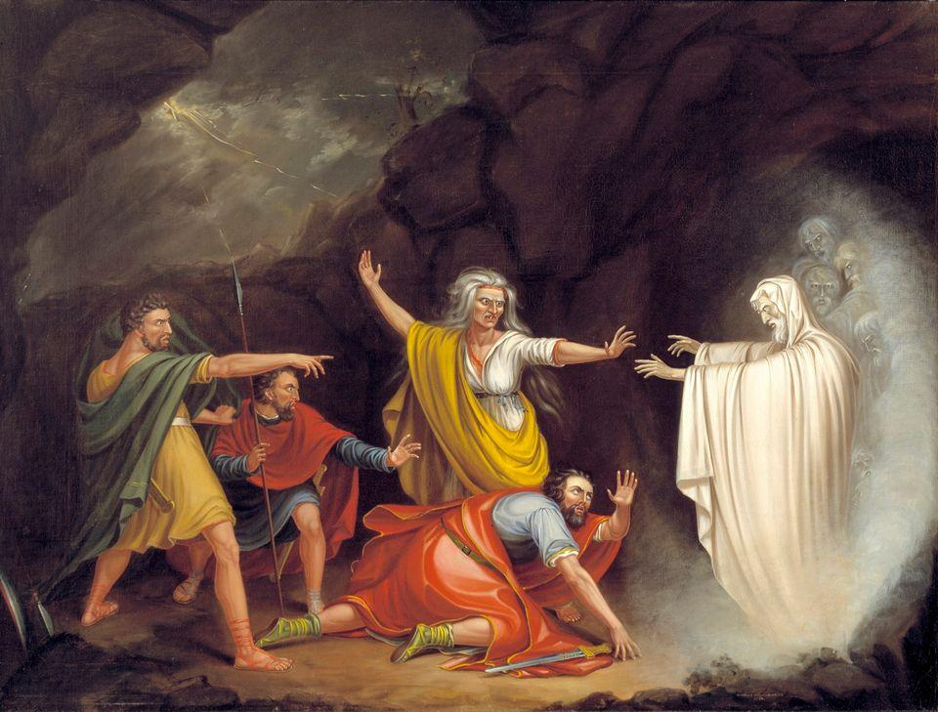
Despair & Death
Cornered by the ongoing battle with the Philistines, Saul chooses to seek a medium’s help
His actions go against the very core of Israelite belief & of Mosaic Law
Saul is trying to reach Samuel’s spirit through the medium to regain God’s favor, but Samuel’s spirit instead gives him a message declaring their doom
Saul in the end is surrounded by the bodies of his sons & takes his own life before the Philistines capture him
David mourns the death of Saul & Jonathan in a song
The memorable saying “How the mighty have fallen” comes from this song
William Sidney Mount’s painting of Saul and his encounter with Samuel’s spirit

Slide 7
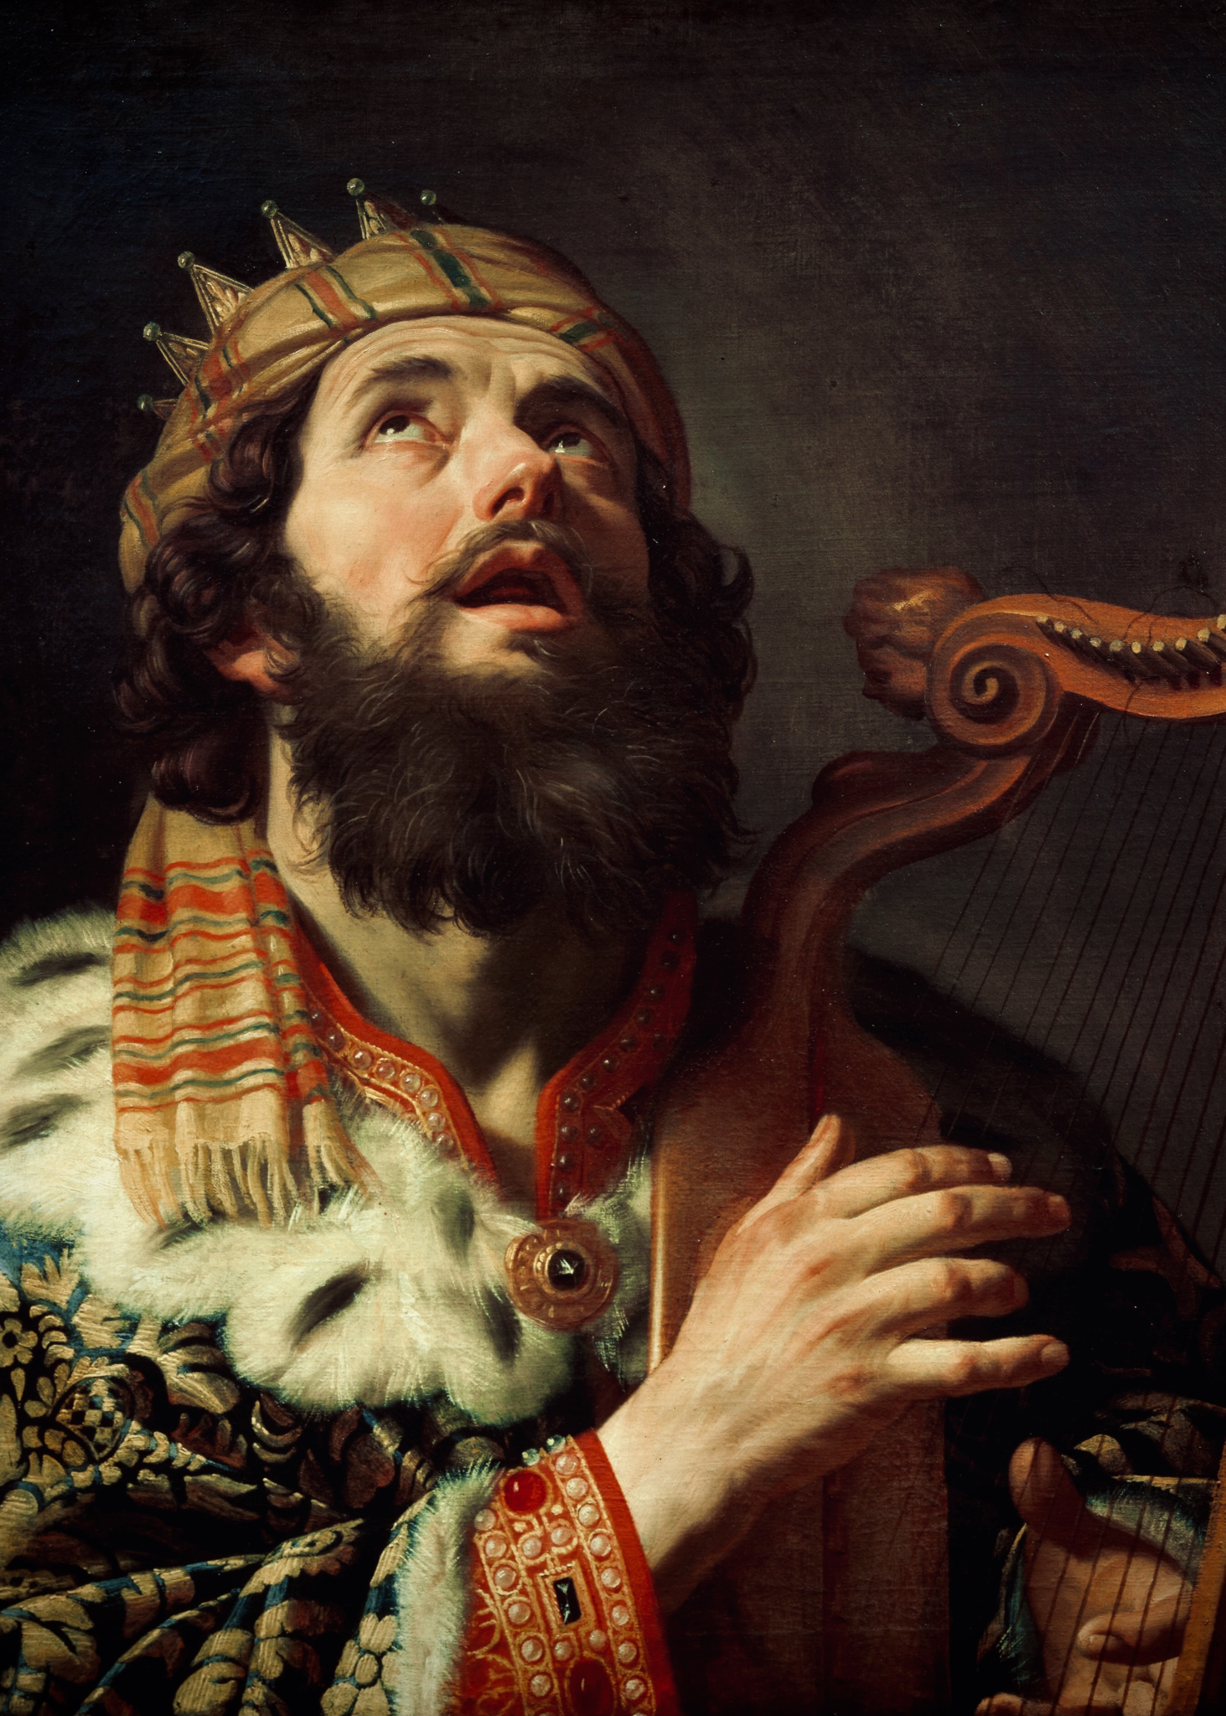
A King and a Capital
David does not take on the role of monarch at the request of Samuel after Saul dies.
While at first Saul’s family takes over, the Israelites eventually come to recognize David’s relationship with God after many battles, leading them to make him king.
Once anointed as king of Israel, David’s first order of business is to take control of the hilltop territory of Zion in Jerusalem. After taking over the land, David names the city the City of David.

Slide 8
David’s Wives
Abigail
First married to Nabal, an evil man who does not follow the rules of hospitality.
While Nabal denies David and his followers of this hospitality, Abigail takes it upon herself to serve them.
When Nabal dies, she then marries David.
Michal
The daughter of Saul.
At David’s celebratory dancing with the Israelites, she chastises him for behaving so informally with his subjects as king.

Slide 9
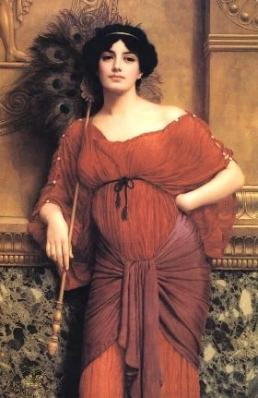
Bathsheba
Yet another one of David’s wives, though she starts off being married to Uriah.
David has sex with her, and she becomes pregnant with his child.
David then attempts to have her fake becoming pregnant with Uriah’s child by encouraging him to have sex. This plan fails when Uriah refuses, as to do so would violate the code of a good soldier.
Even more desperate, David ends up sending Uriah to the front lines of battle to be killed, freeing her from her marriage so she can marry him instead.
While those three are the only ones mentioned in this chapter, David had a total of seven wives: Ahinoam, Abigail, Bathsheba, Maacha, Haggith, Abital, and Eglah.

Slide 10
Absalom
David’s third son.
After David’s eldest son and heir to the throne, Amnon, is not punished for raping his half-sister Tamar, Absolm takes it upon himself to enact justice, having him killed.
In response to this, David exiles him, and the two become enemies with Absalom eventually leading a rebellion against David.

Slide 11
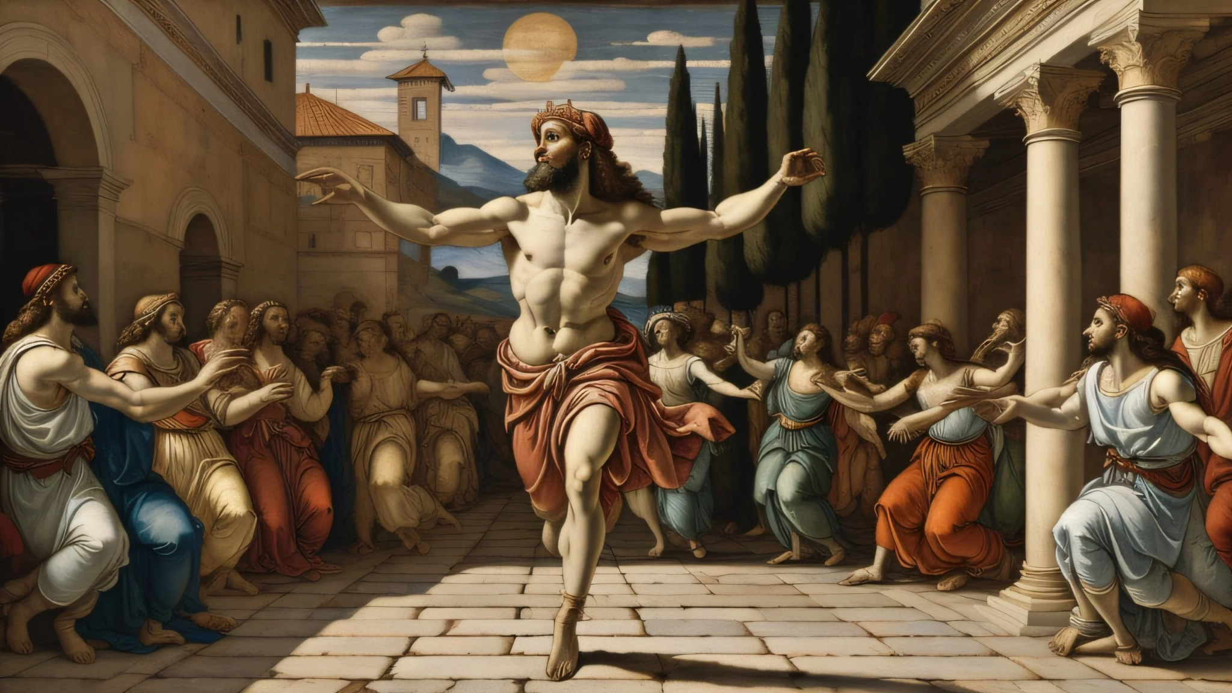
A Legacy
At the end of his life, David makes Solomon, Bathsheba’s son, his heir.
David is celebrated as the greatest king of Israel.
He is so beloved in part due to the flaws that make him human. While he makes mistakes, he eventually recognizes this and repents for his actions.
David’s legacy is ultimately about him having “laid the foundations for Jerusalem.”

