Slide 1
Unit of Study
The Impacts on students from
Fantasy Fiction

Slide 2
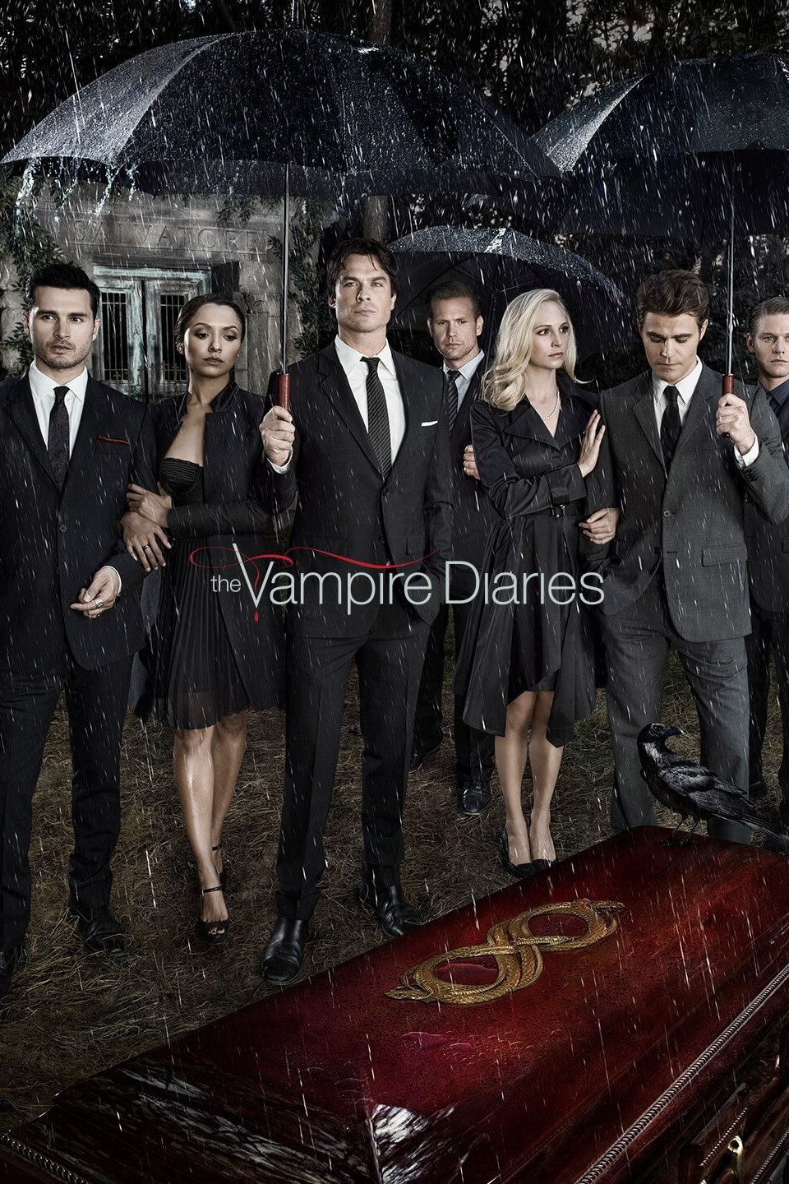
The diaries of Vampires
By L.J. Smith
A combination of all fantastic creatures such as vampires, witches, and werewolves, The Diaries of Vampires by L.J. Smith creates the whole new story swing around those powerful three and the love triangle between human, vampires, and werewolves. Vampire literature covers the spectrum of literary work concerned mostly with the subject of vampires.

Slide 3
What Does Fantasy Fiction Offer?
It offers the chance to see the world from a different angle
Always have meaningful messages
It tells that love does exist in fantasy world
Friendships connect everyone together
Family is the top priority

Slide 4
Harry Potter and The Prisoner of Azkaban
Fantasy fiction happens to give readers, especially young readers, the ideas of what a wonderful-opposite world fantasy is and how it can change or control things that reality world can’t ,with magic. Children admire Harry Potter and they want to be like him in one way or another.

Slide 5
Why Fantasy Fiction?
Young readers will absolutely find fantasy fictions much more interesting than any other types of literature.
Fantasy fiction is vital for human mind. It begins as a psychological process by which a child learn to fill the gaps between knowledge, reality, experience, and becomes a vital adult coping mechanism.
Children are born with the full spectrum of human emotions, wild, exciting, passionate, and raring to go. Young readers are inexperienced and ready to explore their feelings, this is why they need to be scared and fantasy is a “safe” way to do it.

Slide 6
Methods to Teach
Introduce the fantasy story and provide a list of new vocabulary from the readings
Each student takes turn to read the novel(s)
Divide students into groups and give each group an important chapter/passage to discuss
Identify the main theme, how it implies, and the message each chapter/passage gives
Share ideas with the class
30-minute in class essay: what did you learn from reading the novel? Pick one quote from the reading and explain why it’s significant. Who plays the important role in the readings?

Slide 7
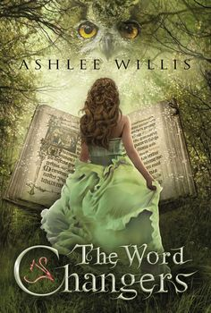
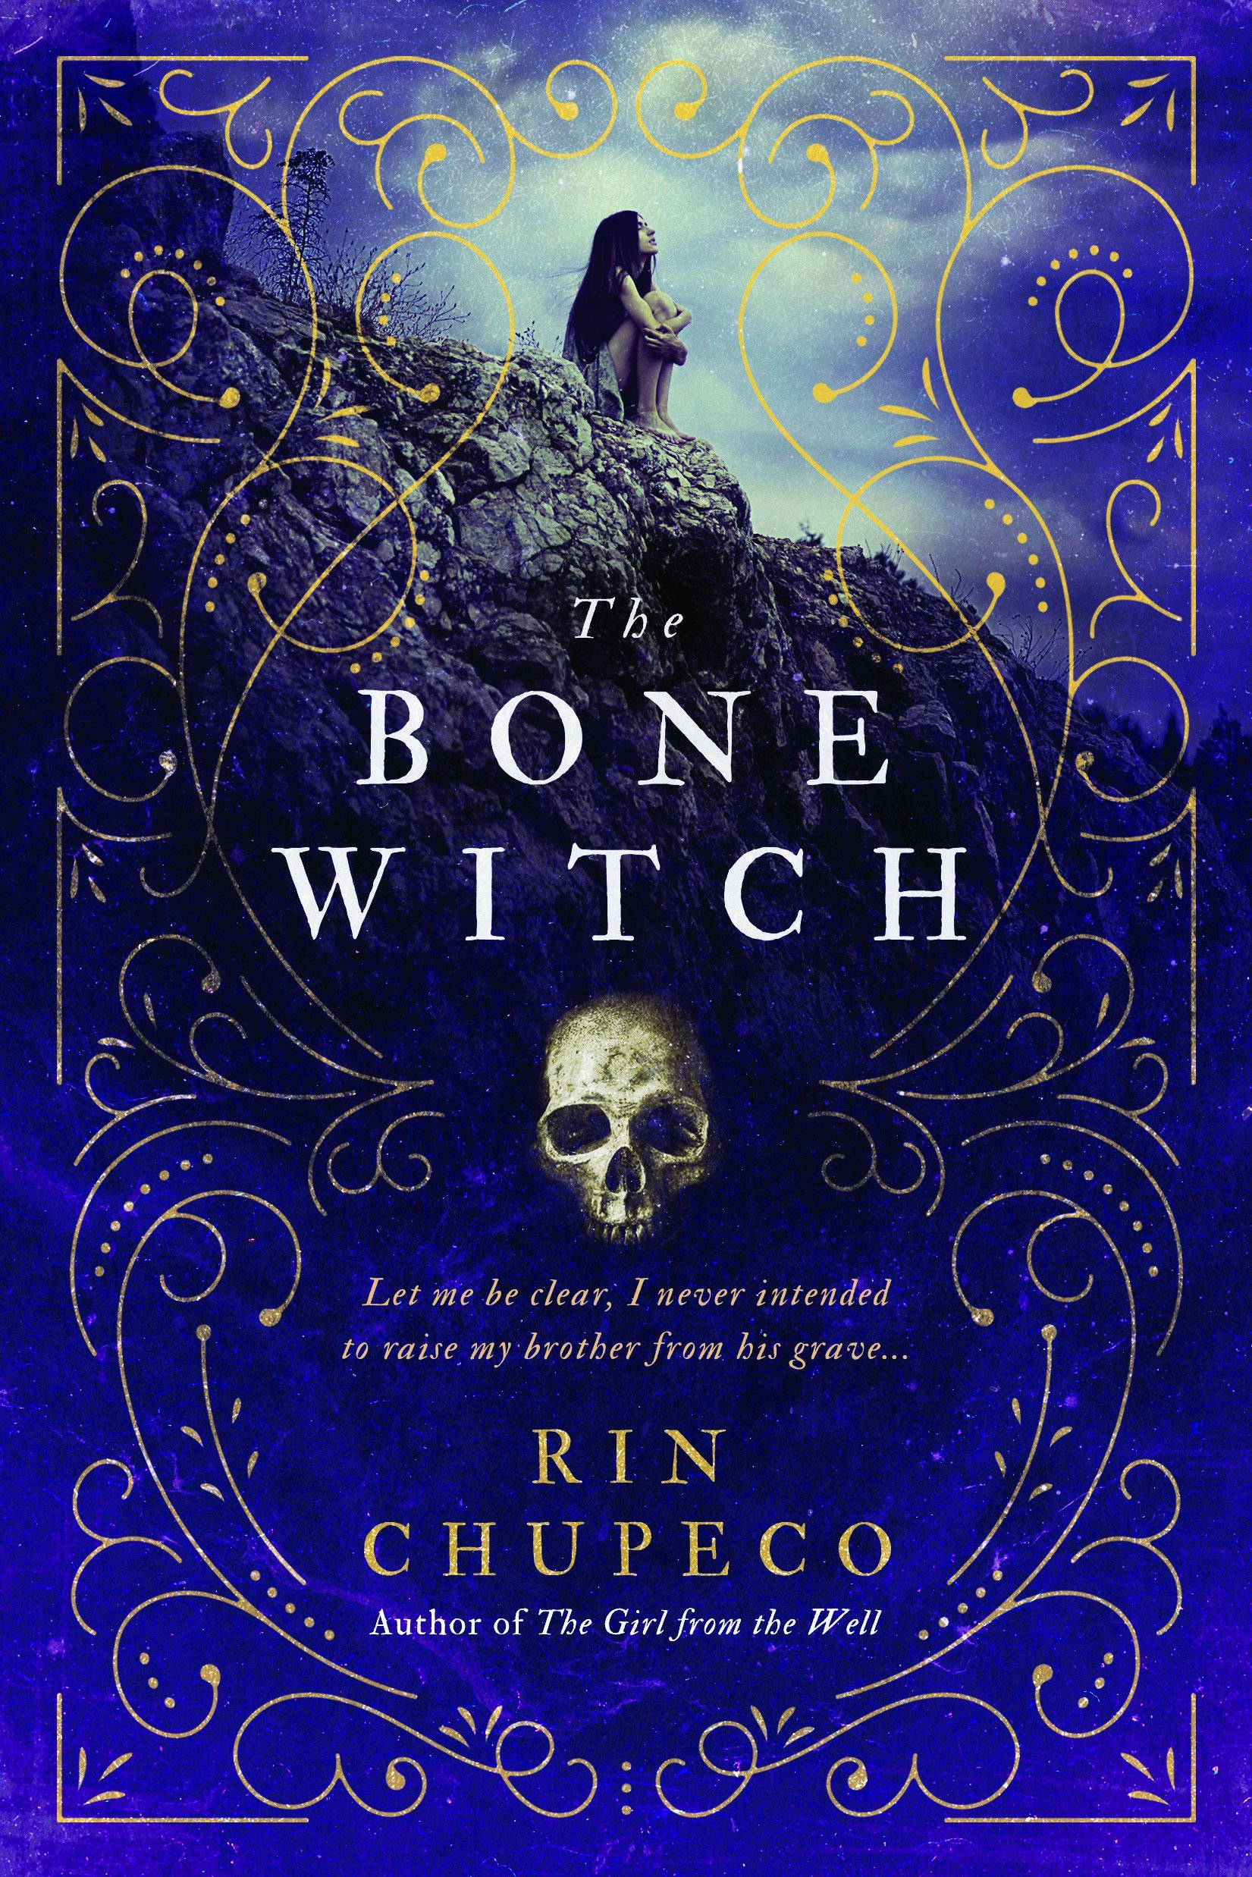
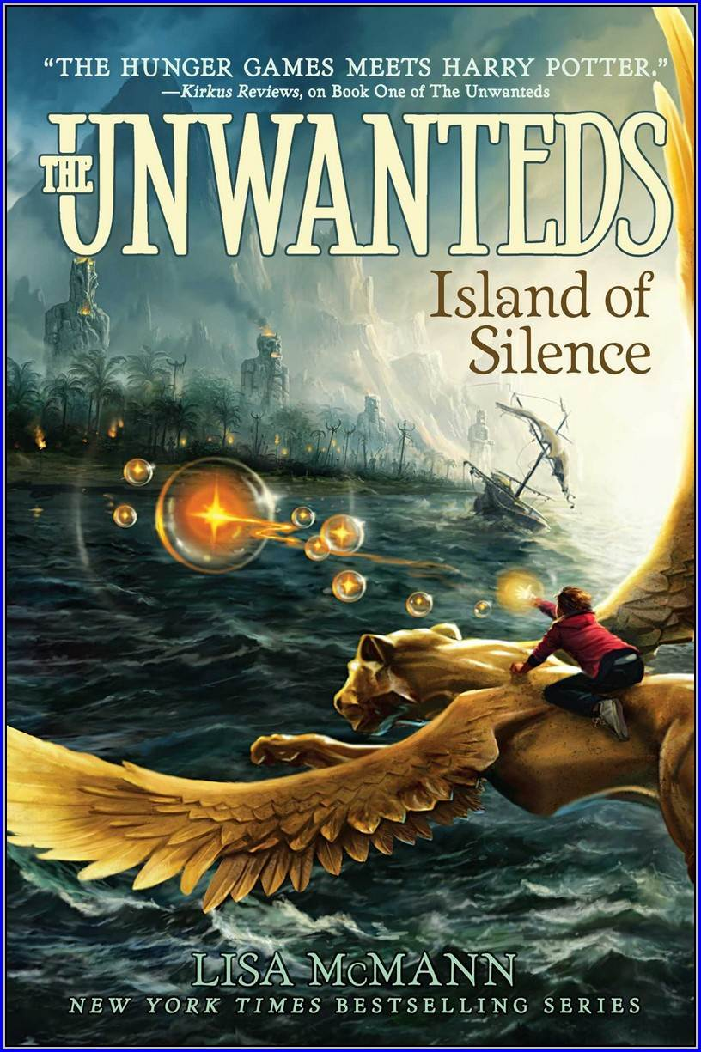
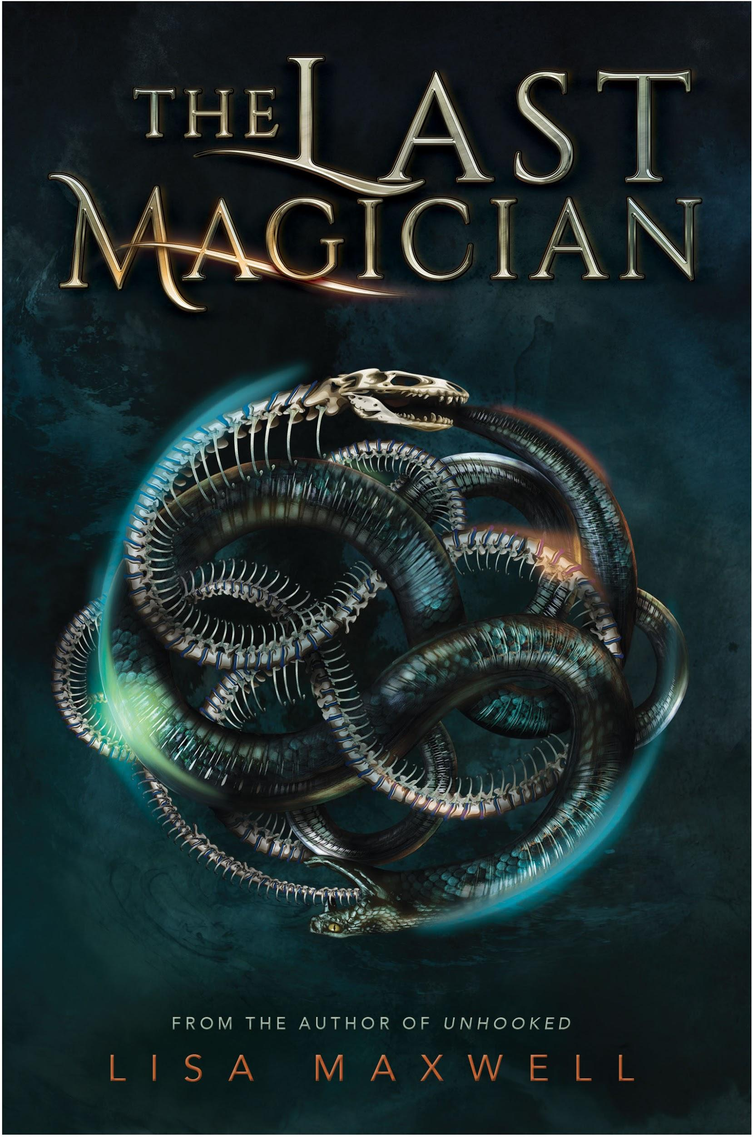
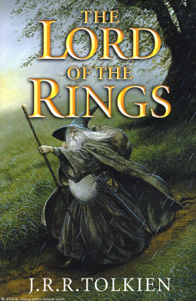
Others Fantasy Stories

