Slide 1
Last class before final exam
5/11/16
Intro Health Stats

Slide 2
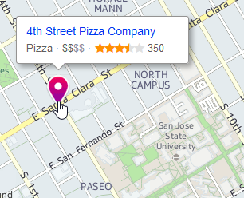
Exam on 5/16/16
Same format and rules as other exams
One 4x6 cheat sheet (second blank card distributed so you can create a draft version)
After exam party starting at 12:30 @ 4th St. Pizza – 4th and Santa Clara

Slide 3
Coverage
Everything since week 10 (includes Law of Farm, Murphy’s Law, self-correction, etc.)

Slide 4
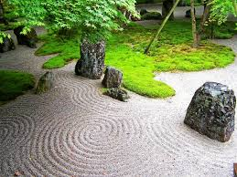
Review HW8
I can tell you are being pulled in 25 different directions
So first we must calm down and focus

Slide 5
HW8 Question 8.2
(A) A researcher compares needle stick injuries from community-based and tertiary-care hospitals.
ANS (A): Independent samples
(B) A technician … takes 10 measurement of a specimen and compares it to its known concentration.
ANS (B): Single sample
(C) A lab technician compares a new method of testing water to an established method by comparing 10 specimens using each method.
ANS (C): Paired samples

Slide 6
Consider the research question below: 3 sampling possibilities: single, paired, or independent?
(A) Men taking testosterone replacement therapy (TRT) are followed to see if have a heart attack.
(B) Men taking TRT and men not taking TRT are followed to see if they have a heart attack.
(C) Men taking TRT are matched to men not taking TRT with matching on age, region, and comorbid conditions. Men are followed to see if they have a heart attack.

Slide 7
Do we need to review how to do a boxplot? → standing/walking obese
Obese (group 2)
Q0 456.6
Q1 567.6
Q2 575.8
Q3 621.3
Q4 646.3
F_{L} 487.05
F_{U} 701.85
Any outside values?
456.6 – outside lower
463.3 – outside lower
567.6 – inside lower
567.6
572.8
578.7
591.4
621.3
646.2
646.3 – inside upper

Slide 8
+/- Interpretation of scientific studies (John Oliver, comedian)
http://youtu.be/0Rnq1NpHdmw

